Slide 1





Machine learning approaches to (i) predicting response to therapy in diabetes, (ii) data-driven diabetes subtype classification and (iii) synthetic data generation
Chris Sainsbury
Queen Elizabeth University Hospital, Glasgow
NRS Senior Fellow
Hon Senior Research Fellow, University of Birmingham
@csainsbury
http://glucose.ai
http://github.com/csainsbury/

Slide 2
MD: endothelial function
mathematical modelling of systemic/pulmonary circulation
inpatient CBG data analysis
patient risk stratification
system performance analysis (clinical unit / individual operator)
just-in-time education for ward staff
SCI diabetes data analysis
HbA1c variability and outcome in T1DM
multiscale / multiparameter variability and outcome
Machine Learning
ANN vs logistic regression vs clinician prediction of DM type at diagnosis
myDiabetesIQ
THINKINGAI group – University of Birmingham

Slide 3
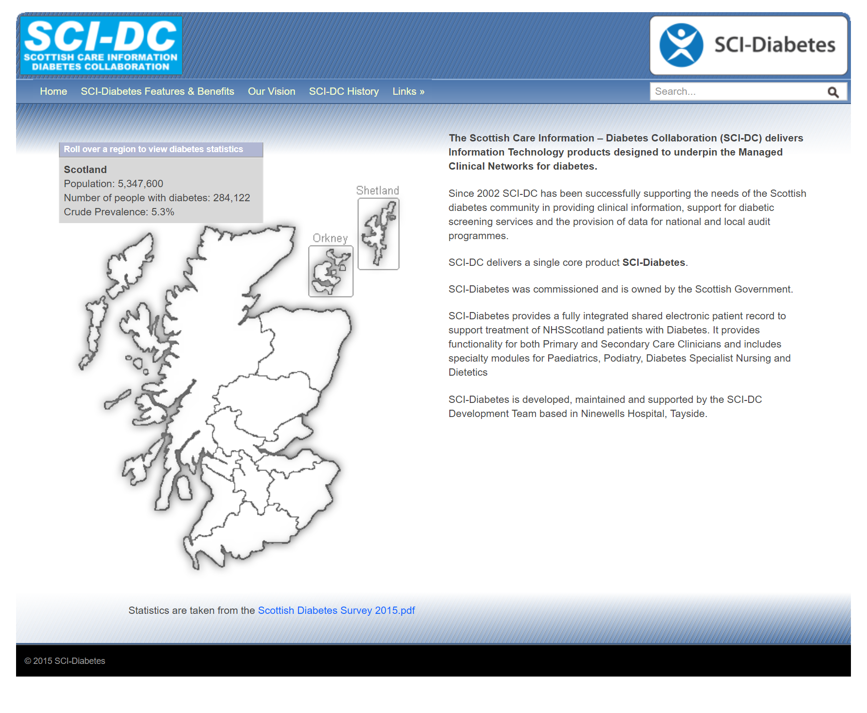
SCI-Diabetes
‘we have (one of) the best datasets in the world, so there is an opportunity to build high quality algorithms to understand relationships within diabetes data…’
what questions to address?

Slide 4
initial questions / prediction problems chosen
suggest best next therapy / combination of therapies to achieve goals in multiple domains (hba1c reduction / blood pressure / mortality etc)
predict complications (LLA, CV events)
predict acute complications (hypoglycaemia etc)
predict diabetes type at diagnosis, identify MODY etc
Notes:
i) prediction of medicine response in individual patients: to improve prescribing, reduce waste and side effects ii) prediction of chronic complications (including lower limb/ cardiovascular disease), iii) prediction of acute complications such as hypoglycaemia (low blood glucose) and ketoacidosis to enable early intervention, and iv) prediction of diabetes type (e.g. type 1, type 2, genetic diabetes (MODY), latent onset autoimmune diabetes) to prevent misclassification, and thereby supporting accurate and safe treatment.

Slide 5

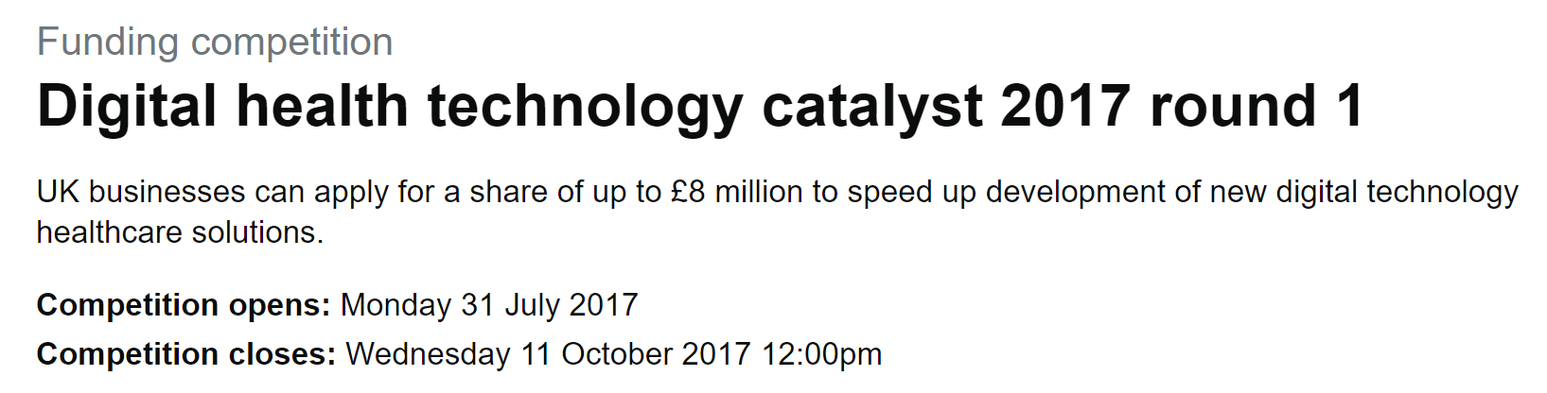
Innovate UK (Digital Health Technology Catalyst)
1M grant 2018-2021
Notes:
i) prediction of medicine response in individual patients: to improve prescribing, reduce waste and side effects ii) prediction of chronic complications (including lower limb/ cardiovascular disease), iii) prediction of acute complications such as hypoglycaemia (low blood glucose) and ketoacidosis to enable early intervention, and iv) prediction of diabetes type (e.g. type 1, type 2, genetic diabetes (MODY), latent onset autoimmune diabetes) to prevent misclassification, and thereby supporting accurate and safe treatment.

Slide 6
Question 1
To generate a prediction of an individual’s response to any given clinically appropriate drug / combination of drugs - drawing on insight gained from the population over time.
or
what is/are the next best drug(s) for my patient?
Notes:
Type 2 diabetes and the clinical problem. The management of type 2 diabetes is complex, and involves multiple domains of interest (average blood glucose, glucose variability over multiple timescales, blood pressure, cholesterol, urinary albumin, foot examination and risk etc (Orsi et al. 2018)), with clinical decisions made on the interaction of these (and multiple other) metrics over time. Clinical guidelines give a range of second and third etc line options, with a recommendation that precise choice should be made in response to the individual. Given that many individuals with diabetes are managed by non-specialist physicians and nurses, this has the potential to lead to suboptimal therapeutic strategies being adopted, and to therapeutic inertia (Khunti et al. 2018).
Machine learning approaches to time series analysis. Analysis of time-series data arising from multiple domains of interest noted above, in addition to time-invariant information (age, sex, ethnicity etc) can be used to understand the relationships between trends in these domains (dimensions) over time, and clinical outcomes of interest (eg reduction in HbA1c, blood pressure or mortality risk). Recurrent neural networks are an example of a machine learning approach that allows this insight to be achieved.
Aim of project. To generate a prediction of an individual’s response to any given clinically appropriate drug / combination of drugs (selection of test drugs driven by clinical guidelines) drawing on insight gained from the population over time.

Slide 7
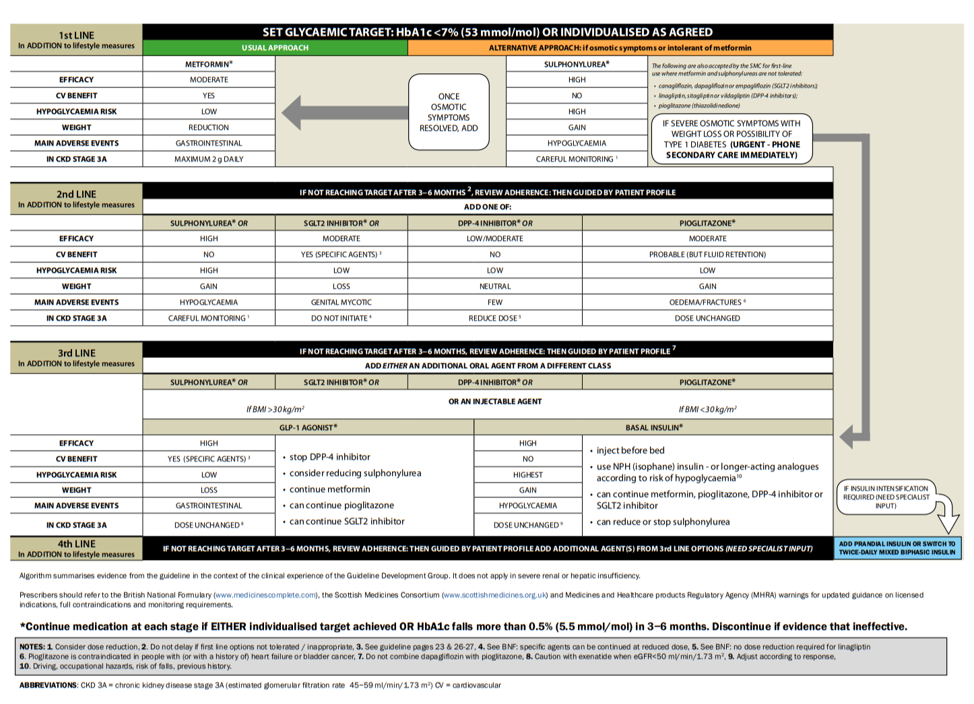
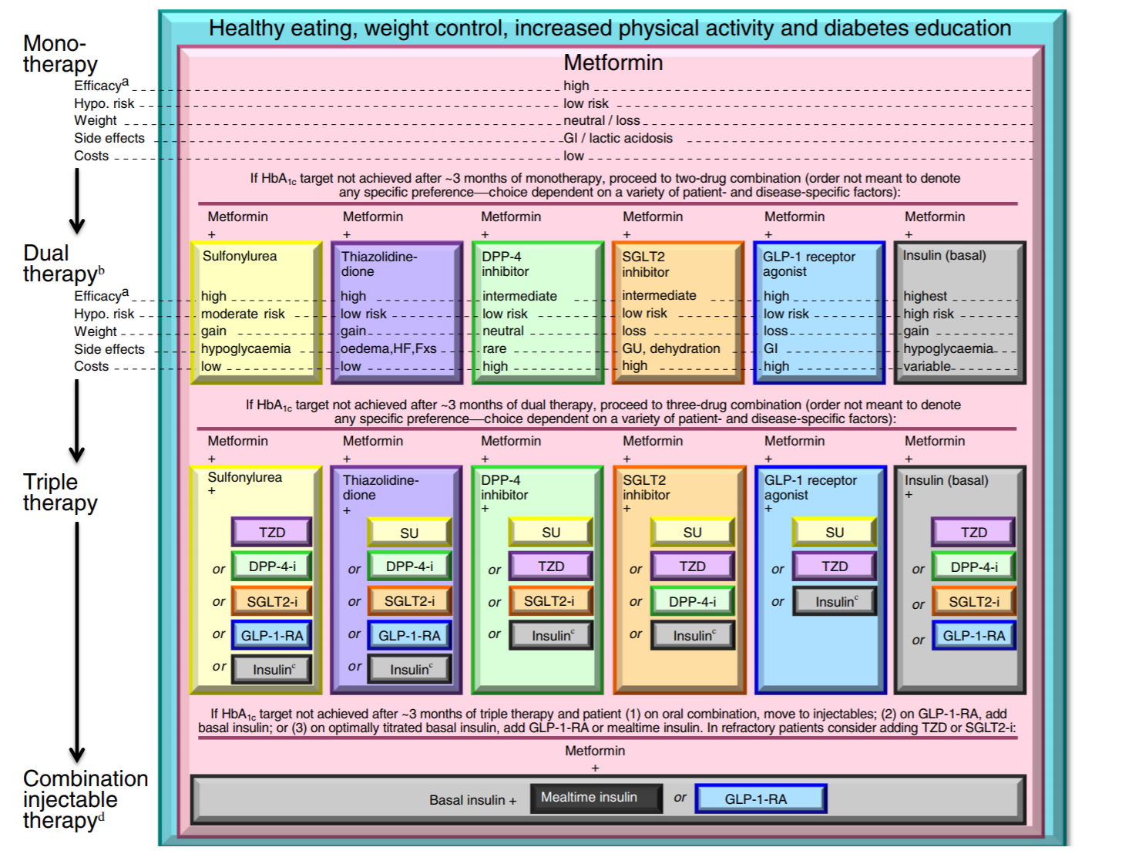
ADA / EASD, 2015
SIGN 154, 2018
Notes:
aim – to find a personalised path through these types of algorithms. ie which of the many options is the best for the individual

Slide 8
what is the next best drug(s) for my patient?
virtual n = 1 drug trial
eg what drug should I prescribe to give this patient the best chance of having an HbA1c <60mmol/mol, with a reduction in blood pressure and BMI in 1 year?
taking into account their individual history of:
HbA1c / BMI / blood pressure
previously prescribed combinations of drug therapies
how previous drugs have impacted on HbA1c / BMI / blood pressure
sex
age
ethnicity
time series
stable over time

Slide 9
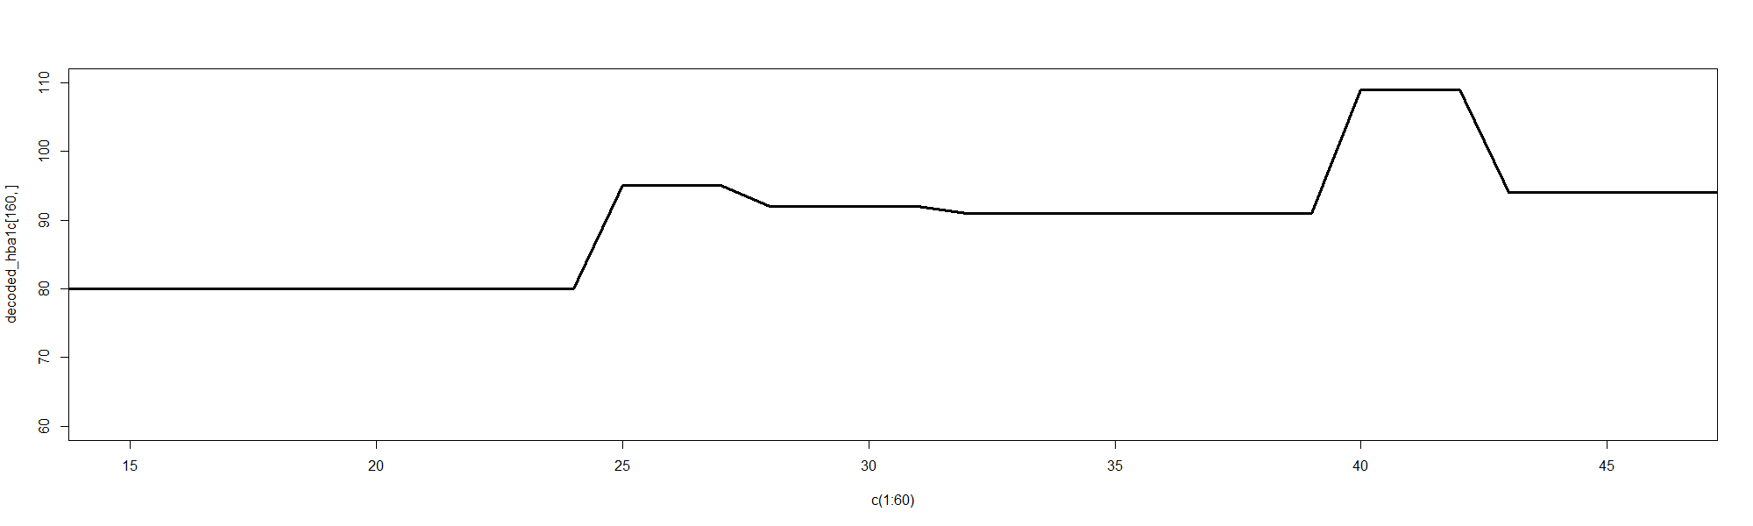
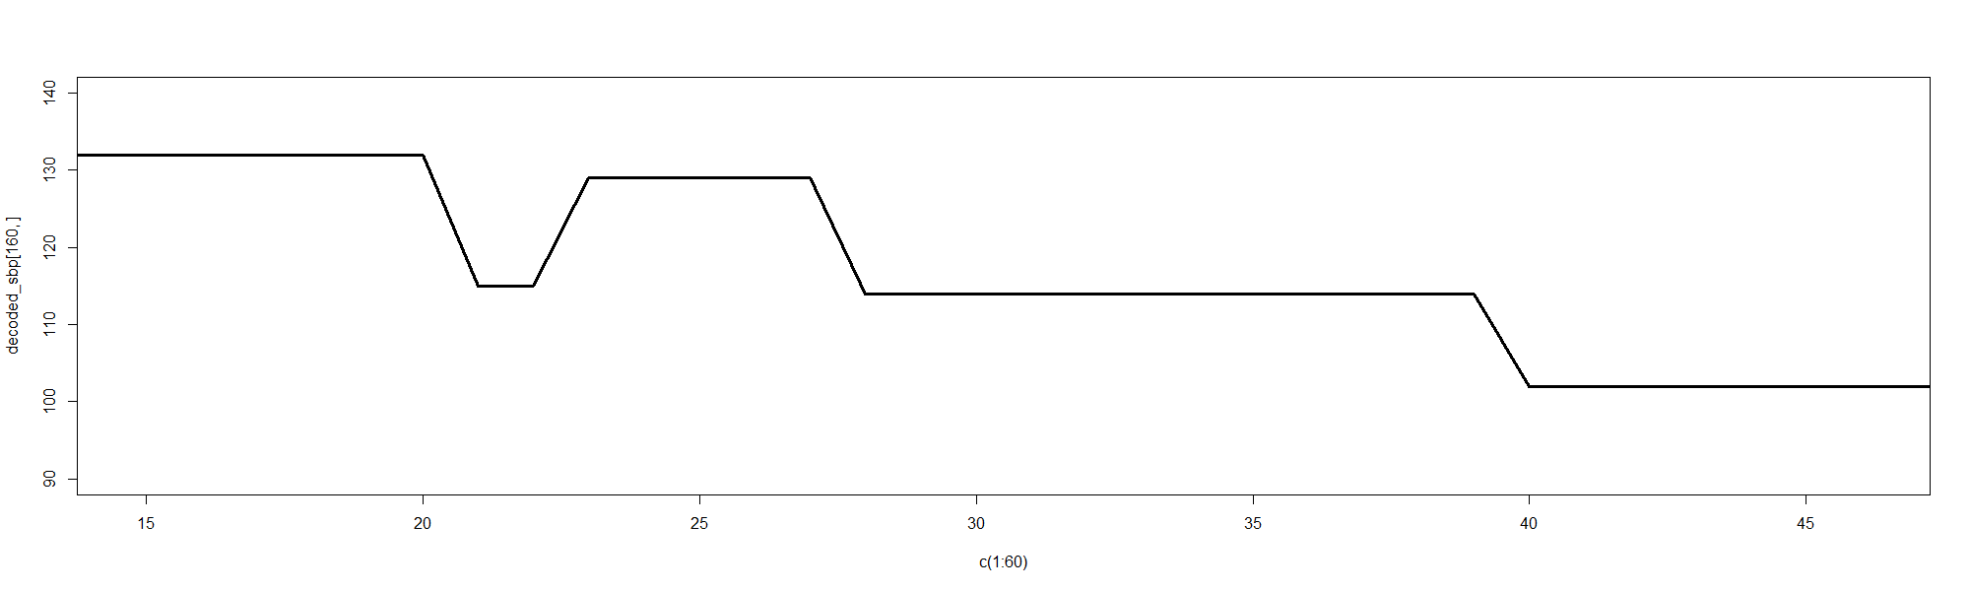
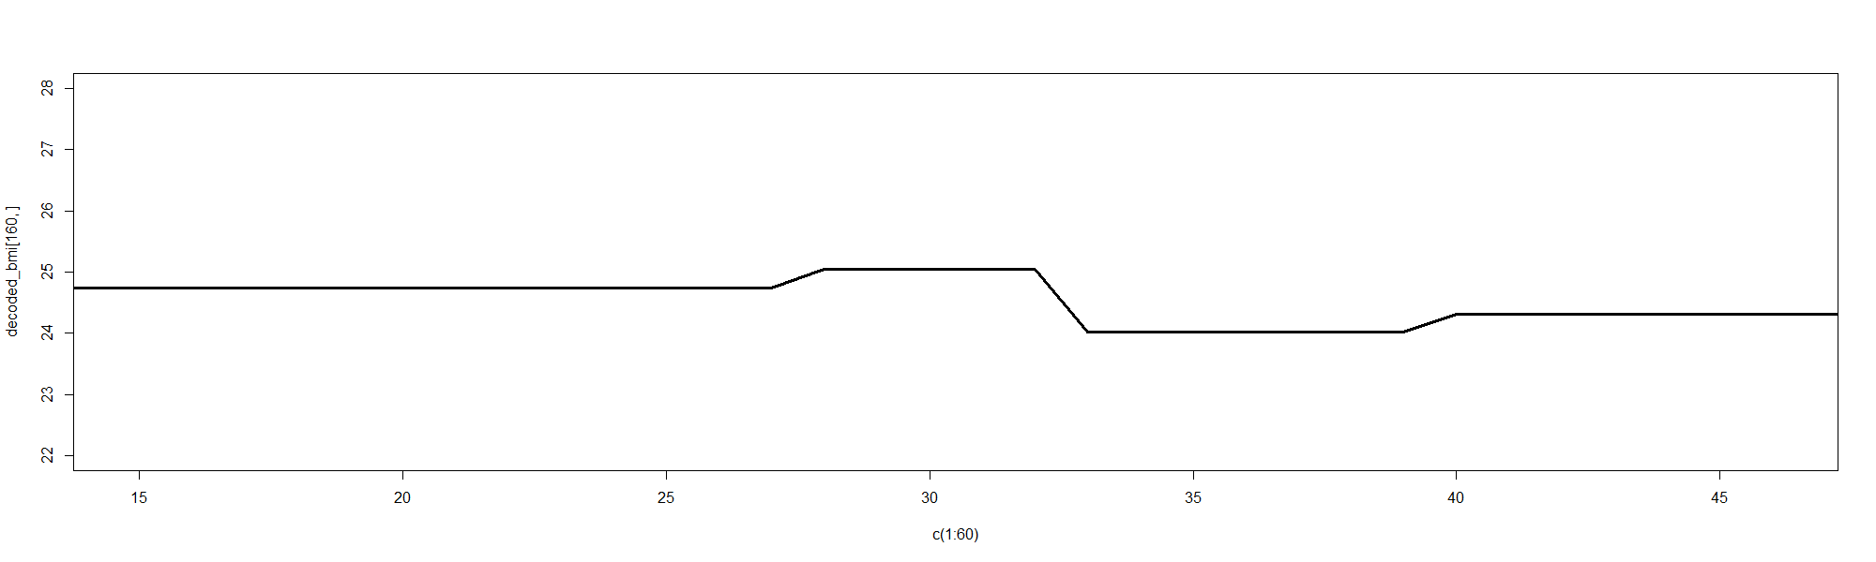
managing time series data – numerical data
hba1c
sbp
bmi
time
Notes:
how do we answer this question 2 – question of combinations. how to approach
NLP, embedding, drug sentences. write new sentences

Slide 10
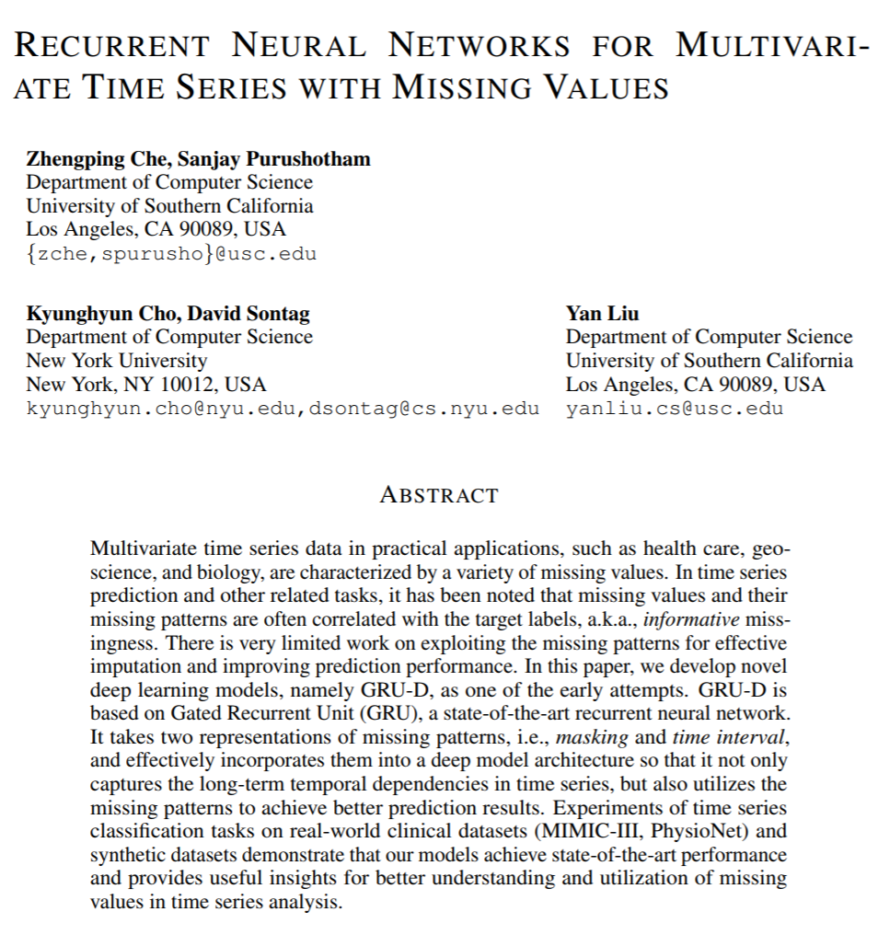
managing time series data – 2
numerical time series
managing missingness
imputation
lvcf / other
interpolation – spline / linear
masking
scaling / normalisation
Notes:
how do we answer this question 2 – question of combinations. how to approach
NLP, embedding, drug sentences. write new sentences

Slide 11
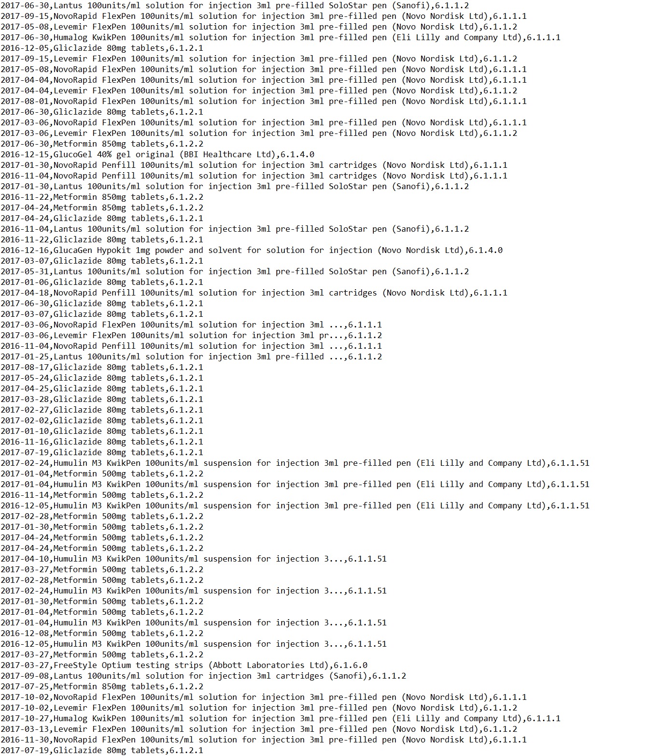
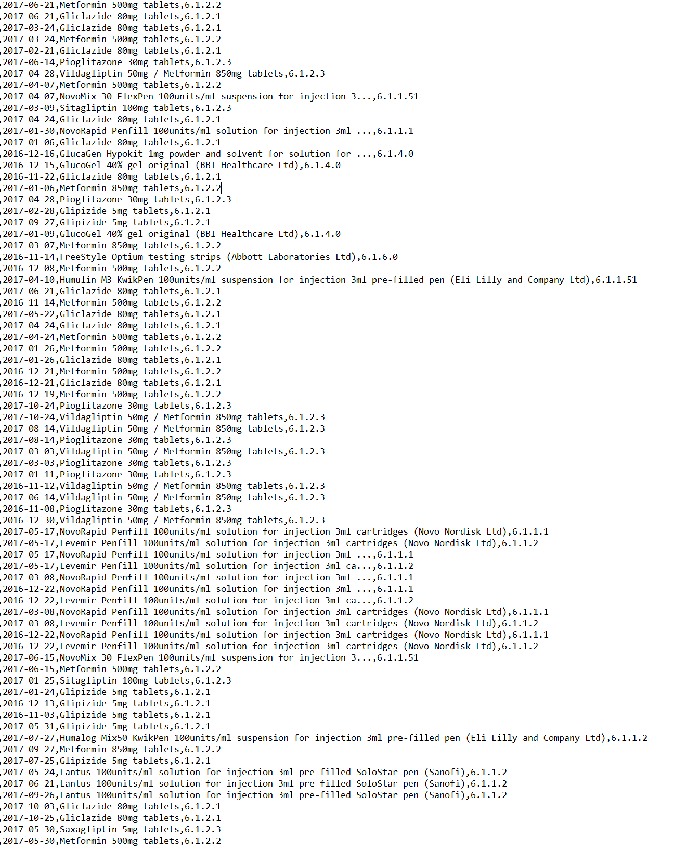
managing time series data – prescription data
Notes:
how do we answer this question 2 – question of combinations. how to approach
NLP, embedding, drug sentences. write new sentences

Slide 12
managing time series data – 3
drug combinations as words - for natural language processing approach
SGLT2
GLP1
GLP1
GLP1
MF
MF
MF
MF
MF
month 0
month 3
month 6
month 12
month 18
MF
GLP1_MF
GLP1_MF_SGLT2
GLP1_MF
Drug Sentence: MF, GLP1_MF, GLP1_MF_SGLT2, GLP1_MF
Embedding -> numerical vector
input into RNN / LSTM
Notes:
how do we answer this question 2 – question of combinations. how to approach
NLP, embedding, drug sentences. write new sentences

Slide 13
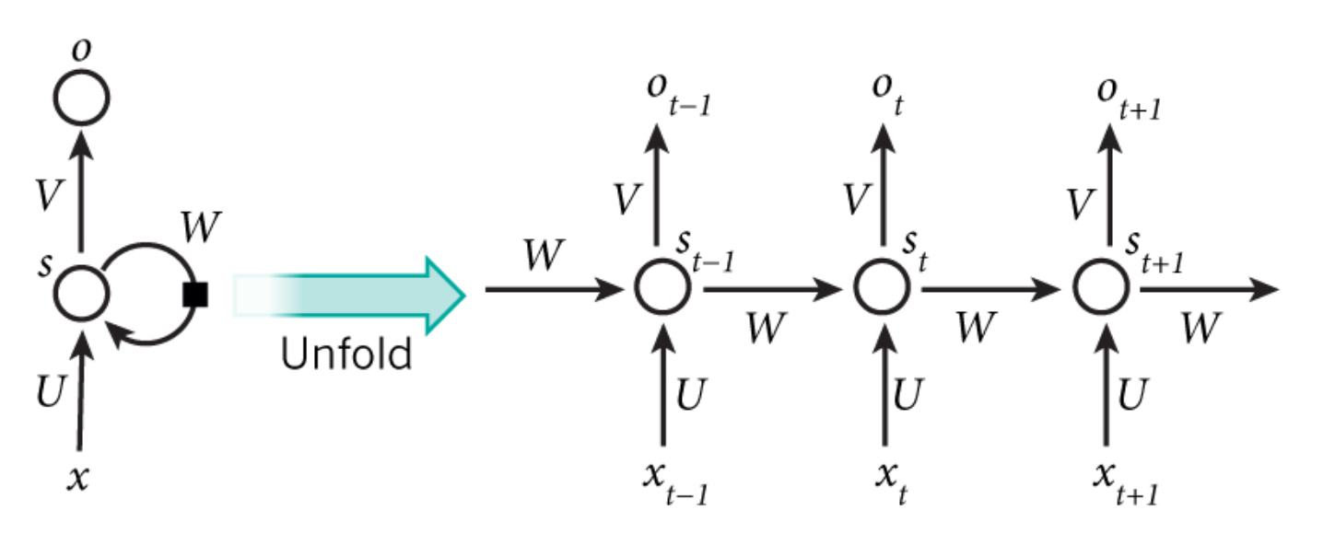
Recurrent Neural Network (LSTM)
extracts information from sequence of input
multi-dimensional RNN extracts information from the interactions between input sequences over time
Notes:
translation, video classification

Slide 14
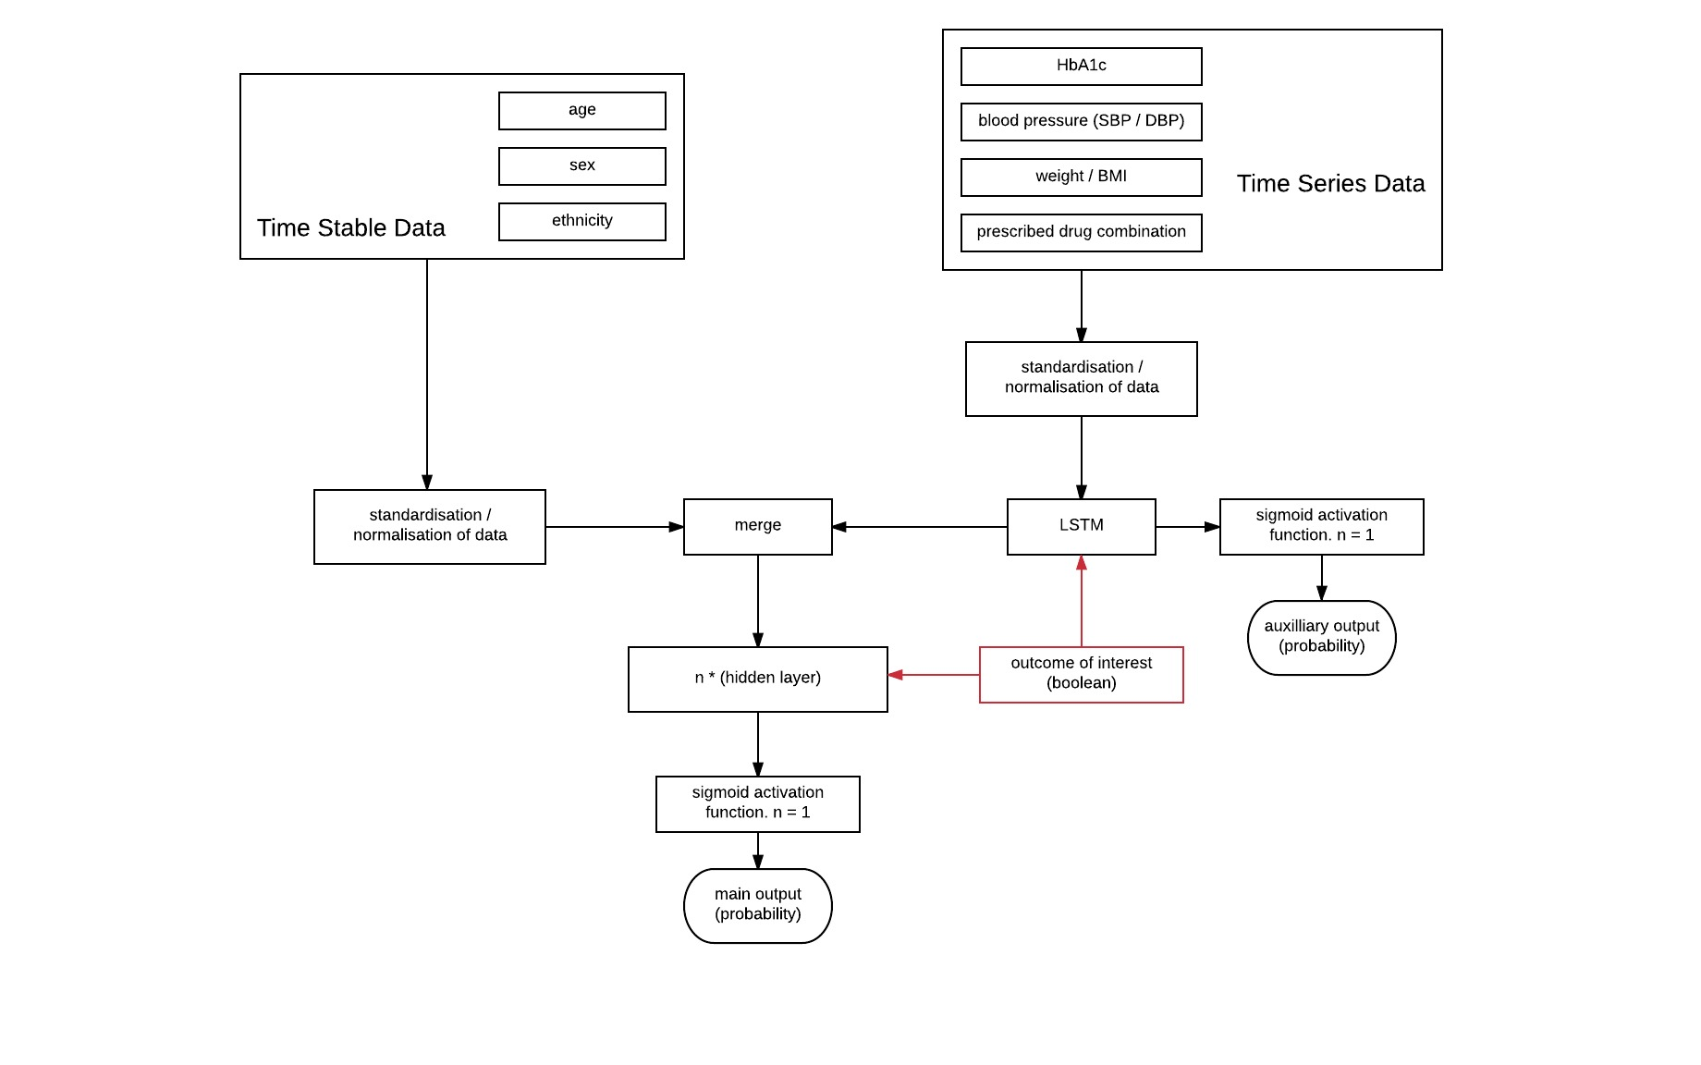
schematic of RNN/LSTM based classifier
Notes:
how do we answer this question 2 – question of combinations. how to approach
NLP, embedding, drug sentences. write new sentences

Slide 15
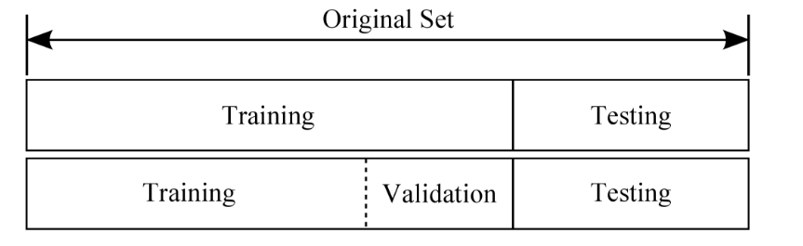
training, validation and withheld test sets
Notes:
i) prediction of medicine response in individual patients: to improve prescribing, reduce waste and side effects ii) prediction of chronic complications (including lower limb/ cardiovascular disease), iii) prediction of acute complications such as hypoglycaemia (low blood glucose) and ketoacidosis to enable early intervention, and iv) prediction of diabetes type (e.g. type 1, type 2, genetic diabetes (MODY), latent onset autoimmune diabetes) to prevent misclassification, and thereby supporting accurate and safe treatment.

Slide 16



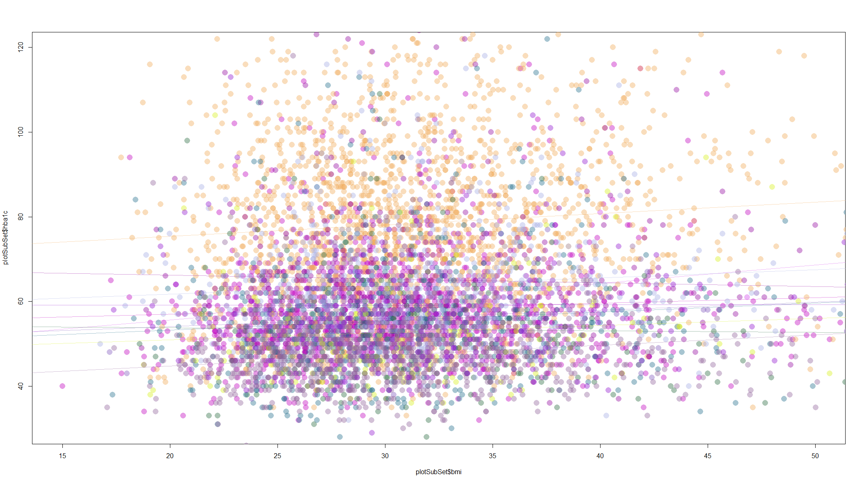

environments used:
SCI diabetes
data input
visualisations
etc
Notes:
how do we answer this question 1 - architecture

Slide 17

runin period
test period
HbA1c
SBP
BMI
Drug Combinations
outcome measure of interest
eg
change in HbA1c
change in SBP
change in BMI
(or final values for regressor version)
training data structure

Slide 18
runin period
test period
HbA1c
SBP
BMI
Drug Combinations
test drug 1
predictions
test drug 2
eg
change in HbA1c
change in SBP
change in BMI
(or final values for regressor)
test drug 3
test drug 4
using the model to predict response

Slide 19
bidirectional LSTM classifier
simple classification endpoint:
eg
probability of a 10mmol/mol reduction in hba1c at 1y
probability of achieving HbA1c in range 48 - 60mmol/mol at 1y
composite endpoints:
eg
probability of achieving HbA1c 48 - 60mmol/mol, with a SBP of <140mmHg
Notes:
i) prediction of medicine response in individual patients: to improve prescribing, reduce waste and side effects ii) prediction of chronic complications (including lower limb/ cardiovascular disease), iii) prediction of acute complications such as hypoglycaemia (low blood glucose) and ketoacidosis to enable early intervention, and iv) prediction of diabetes type (e.g. type 1, type 2, genetic diabetes (MODY), latent onset autoimmune diabetes) to prevent misclassification, and thereby supporting accurate and safe treatment.

Slide 20
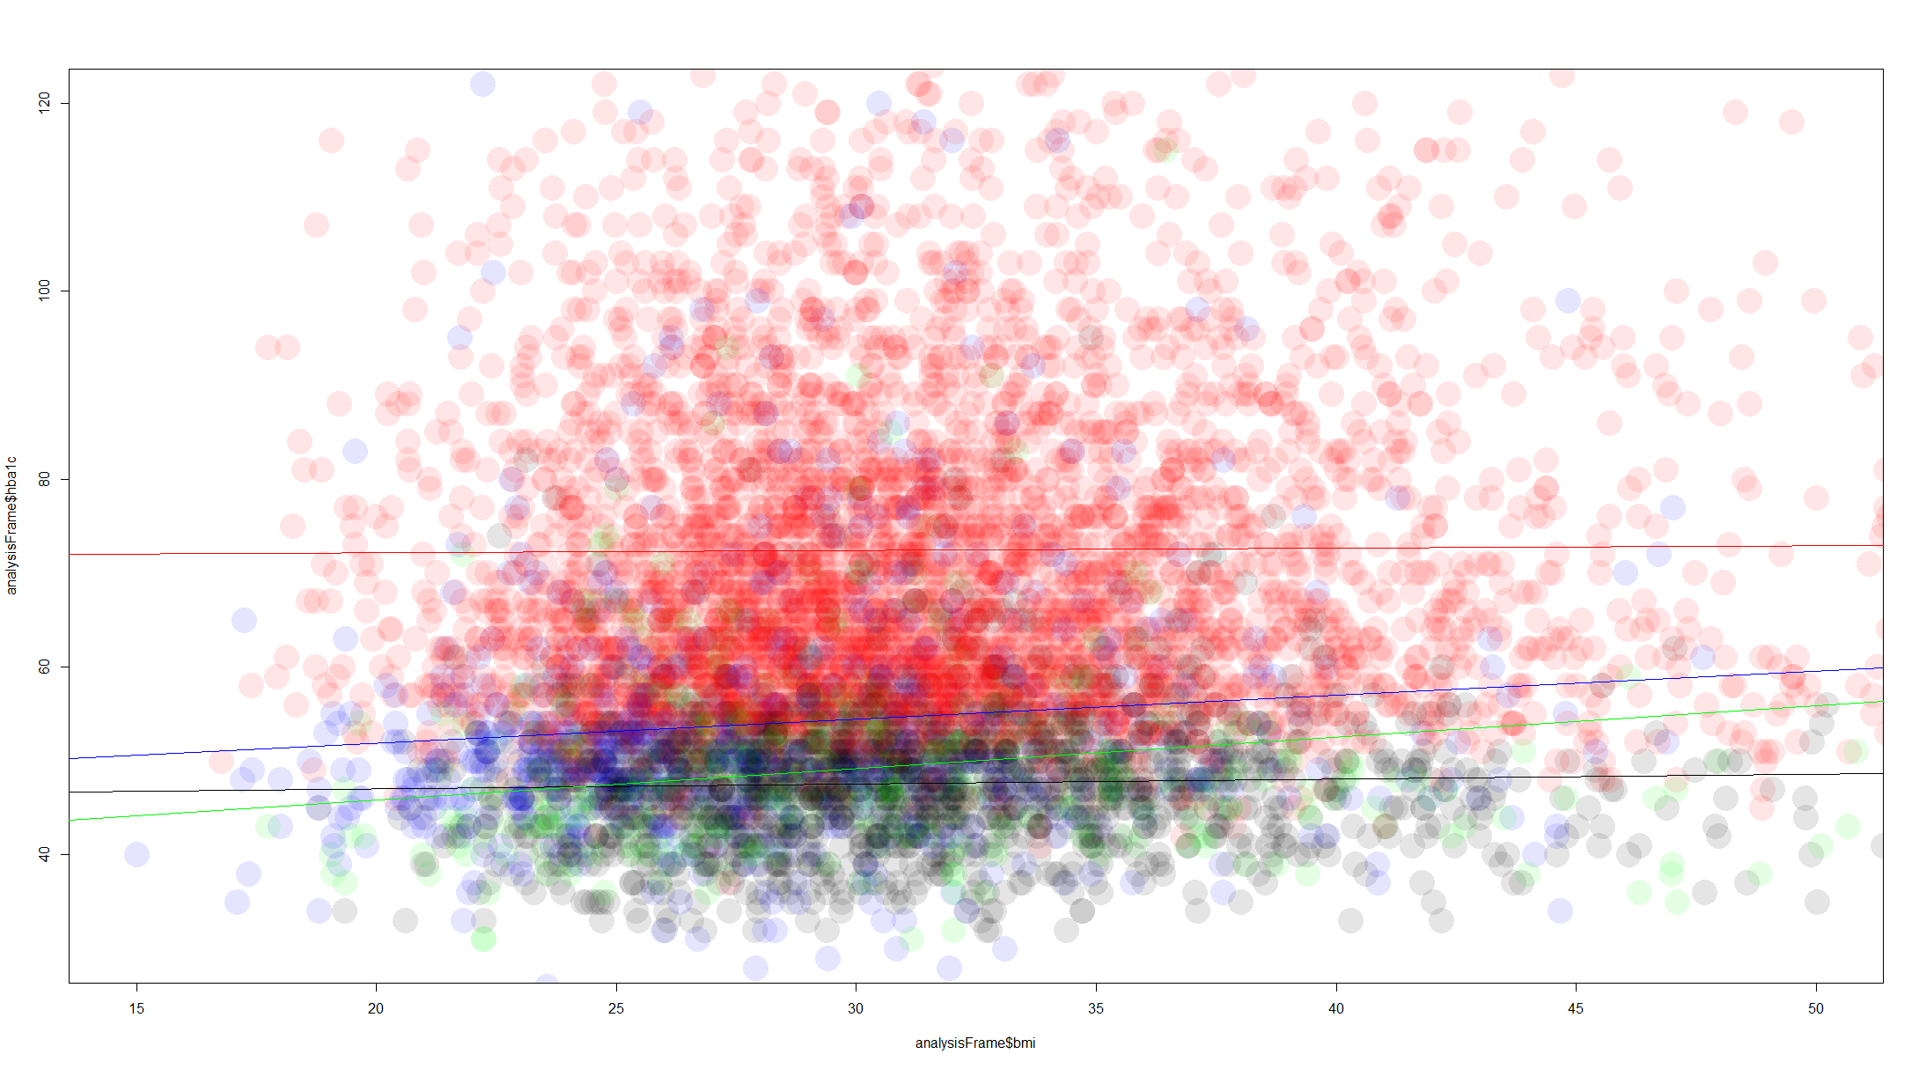
simple problem: which of 4 combinations most likely to reduce hba1c by 10mmol/mol?
last measured HbA1c at end year 4
mf + sglt2
mf + glp1
mf + su
mf + bIns
last measured BMI at end year 4

Slide 21
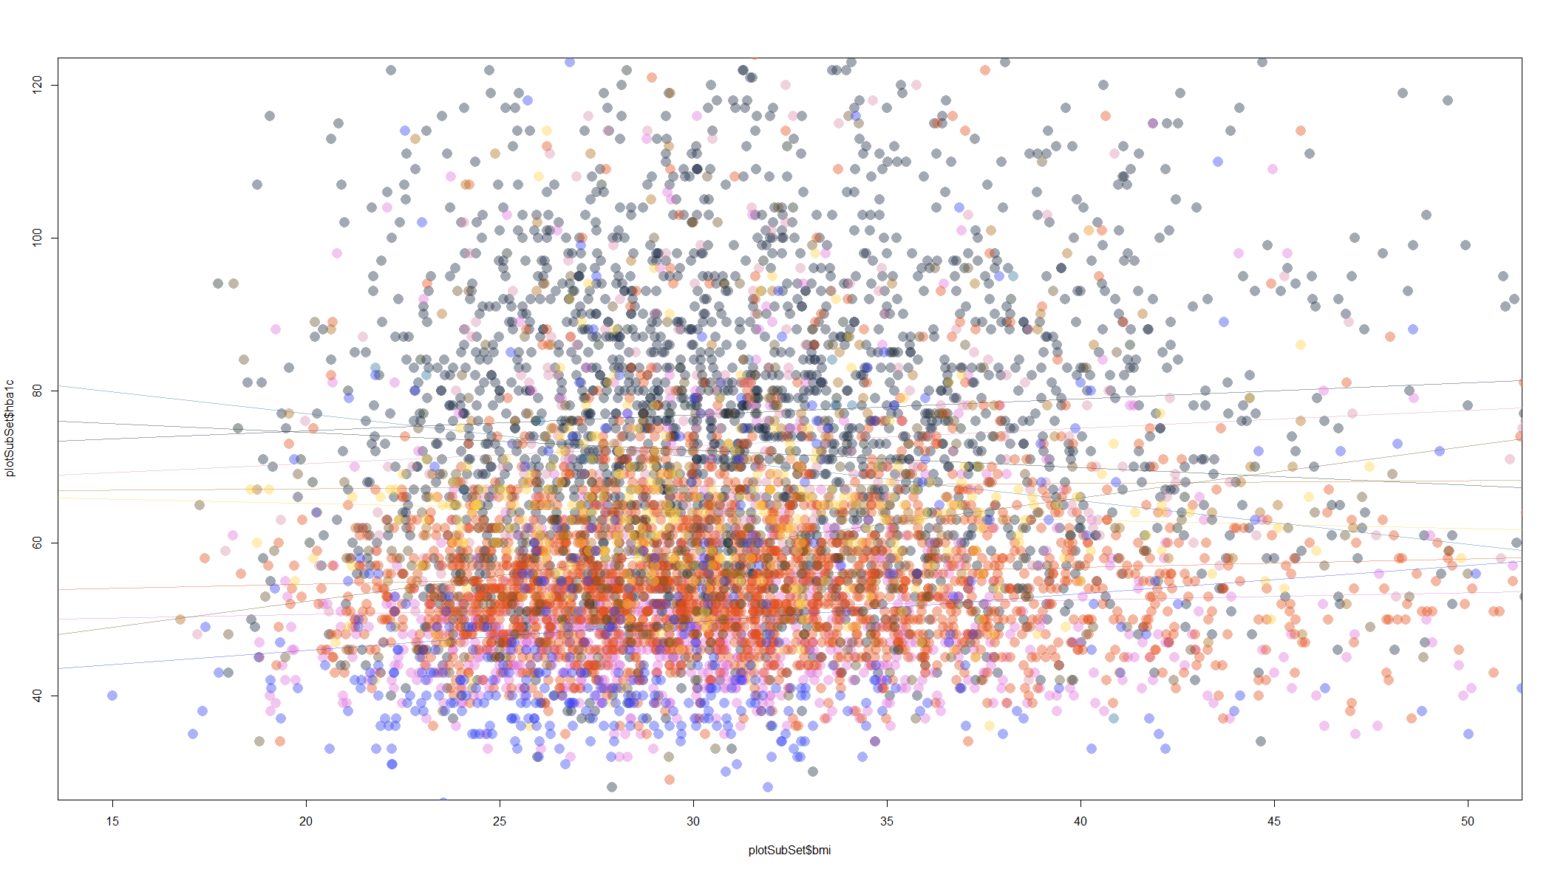
more complex problem: which of 16 combinations most likely to reduce hba1c to <60mmol/mol
without causing weight gain?
last measured HbA1c at end year 4
last measured BMI at end year 4
Notes:
hba1c <60, bmi <1

Slide 22
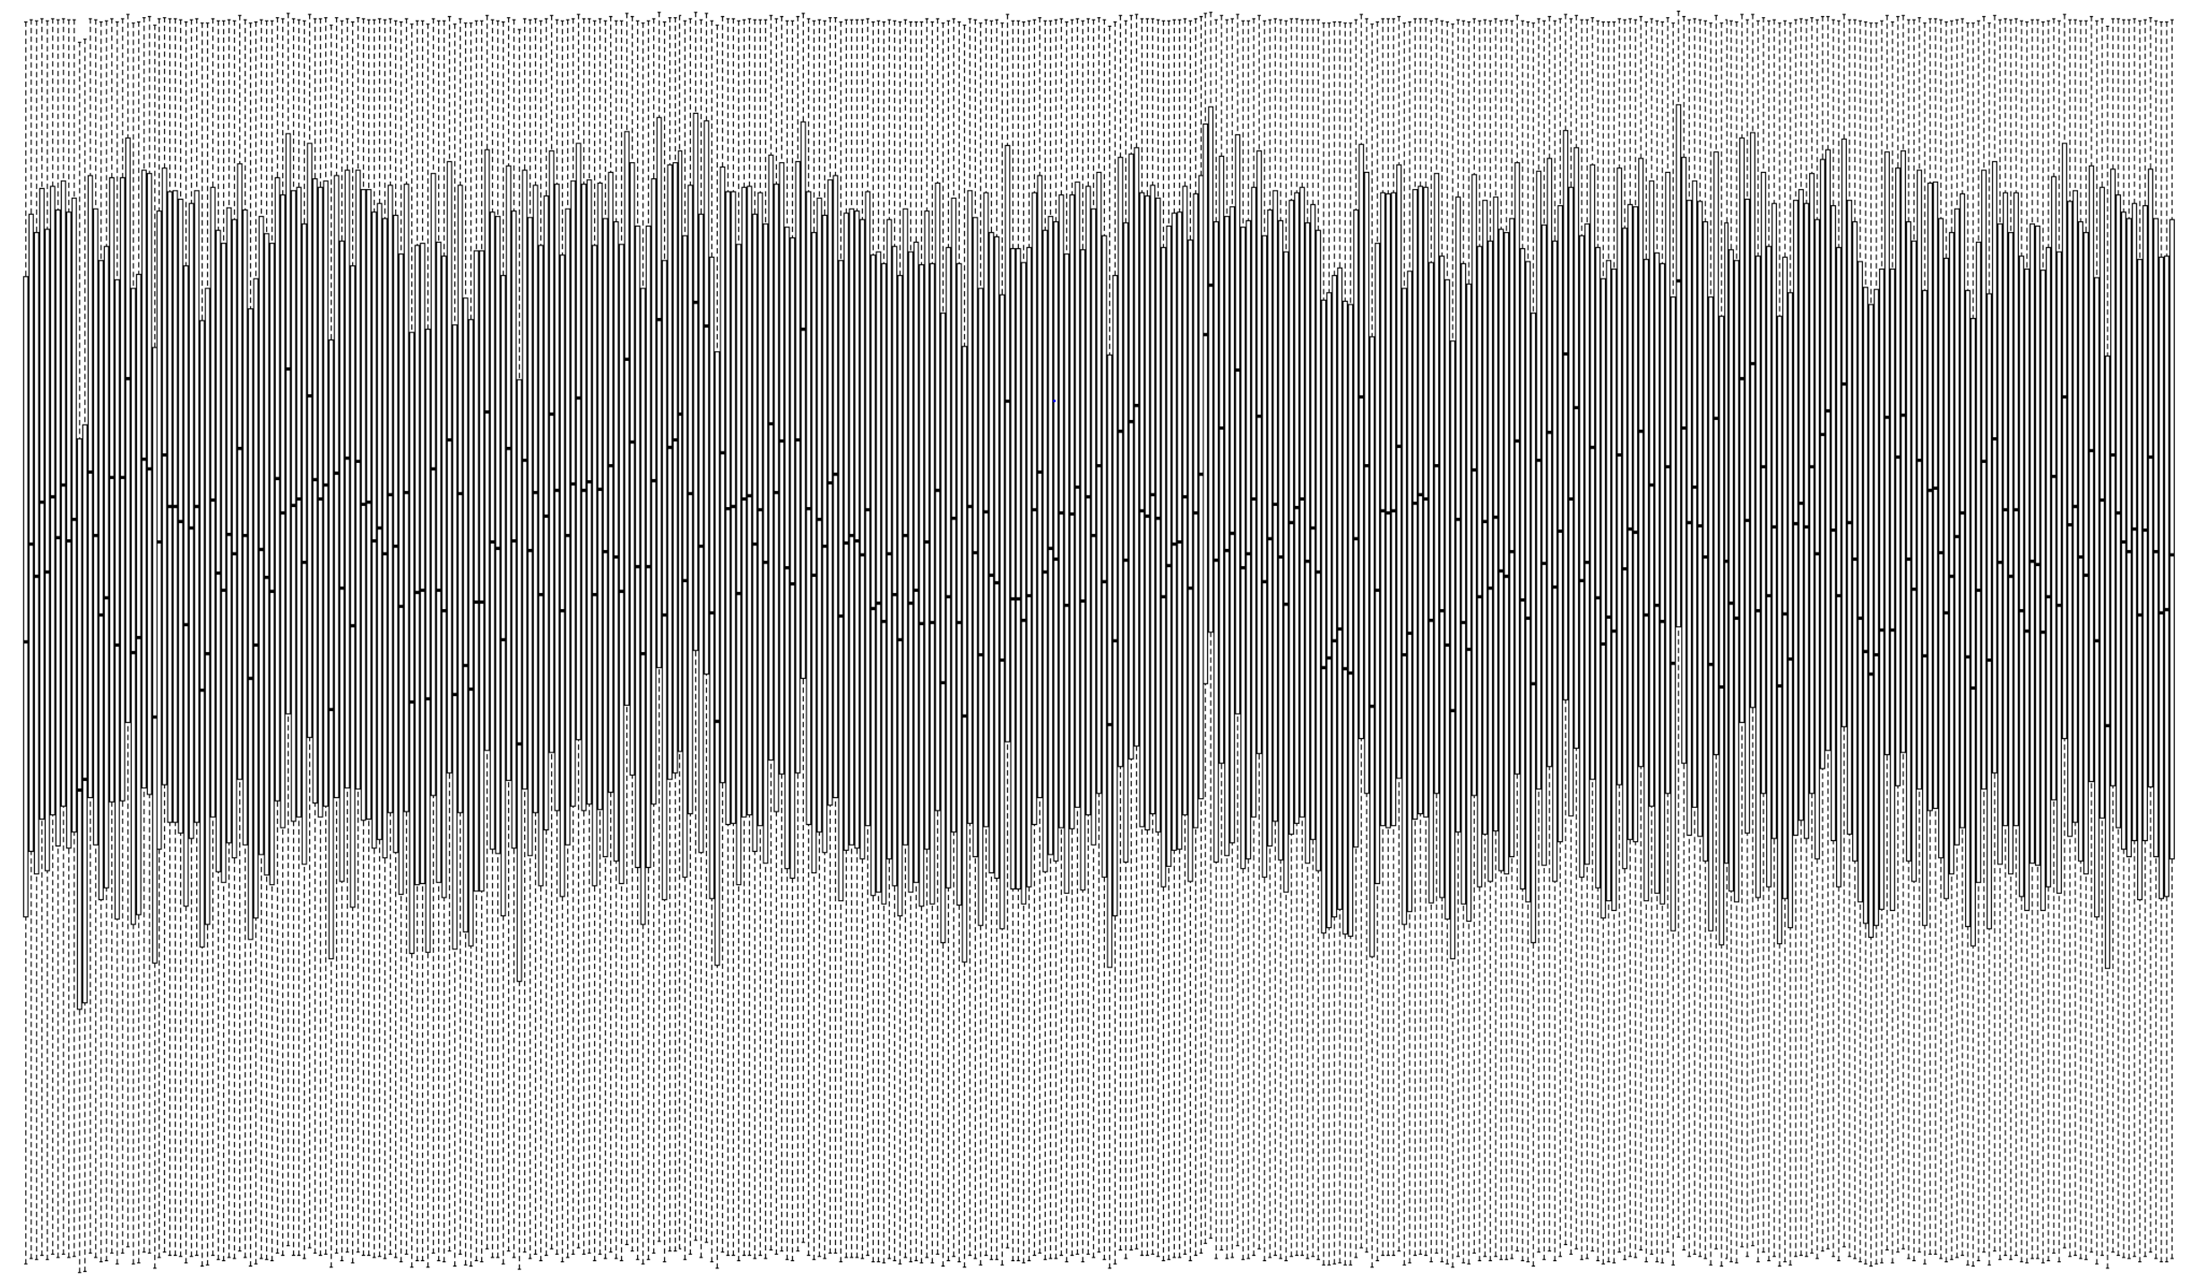
probability of HbA1c reduction >10mmol/mol at 1y n = 1450 (initial HbA1c >60mmol/mol)
probability of HbA1c reduction >10mmol/mol at 1y
drug combinations (400)

Slide 23
mf
mf_su
dpp4_mf
dpp4_mf_su
glp1_mf
glp1_mf_su
mf_sglt2
mf_sglt2_su
dpp4_glp1_mf
dpp4_mf_sglt2
dpp4_mf_tzd
glp1_mf_sglt2
best combination to achieve HbA1c <60mmol/mol, with reduction in BMI
best combination to achieve HbA1c <60mmol/mol, with reduction in SBP

Slide 24
regressor
remove sigmoid activating function from final layer
-> returns value that can be mapped to predicted outcome value (eg HbA1c)
Notes:
i) prediction of medicine response in individual patients: to improve prescribing, reduce waste and side effects ii) prediction of chronic complications (including lower limb/ cardiovascular disease), iii) prediction of acute complications such as hypoglycaemia (low blood glucose) and ketoacidosis to enable early intervention, and iv) prediction of diabetes type (e.g. type 1, type 2, genetic diabetes (MODY), latent onset autoimmune diabetes) to prevent misclassification, and thereby supporting accurate and safe treatment.

Slide 25
auxiliary output
(value)
schematic of RNN/LSTM based regressor
main output
(value)
Notes:
how do we answer this question 2 – question of combinations. how to approach
NLP, embedding, drug sentences. write new sentences

Slide 26
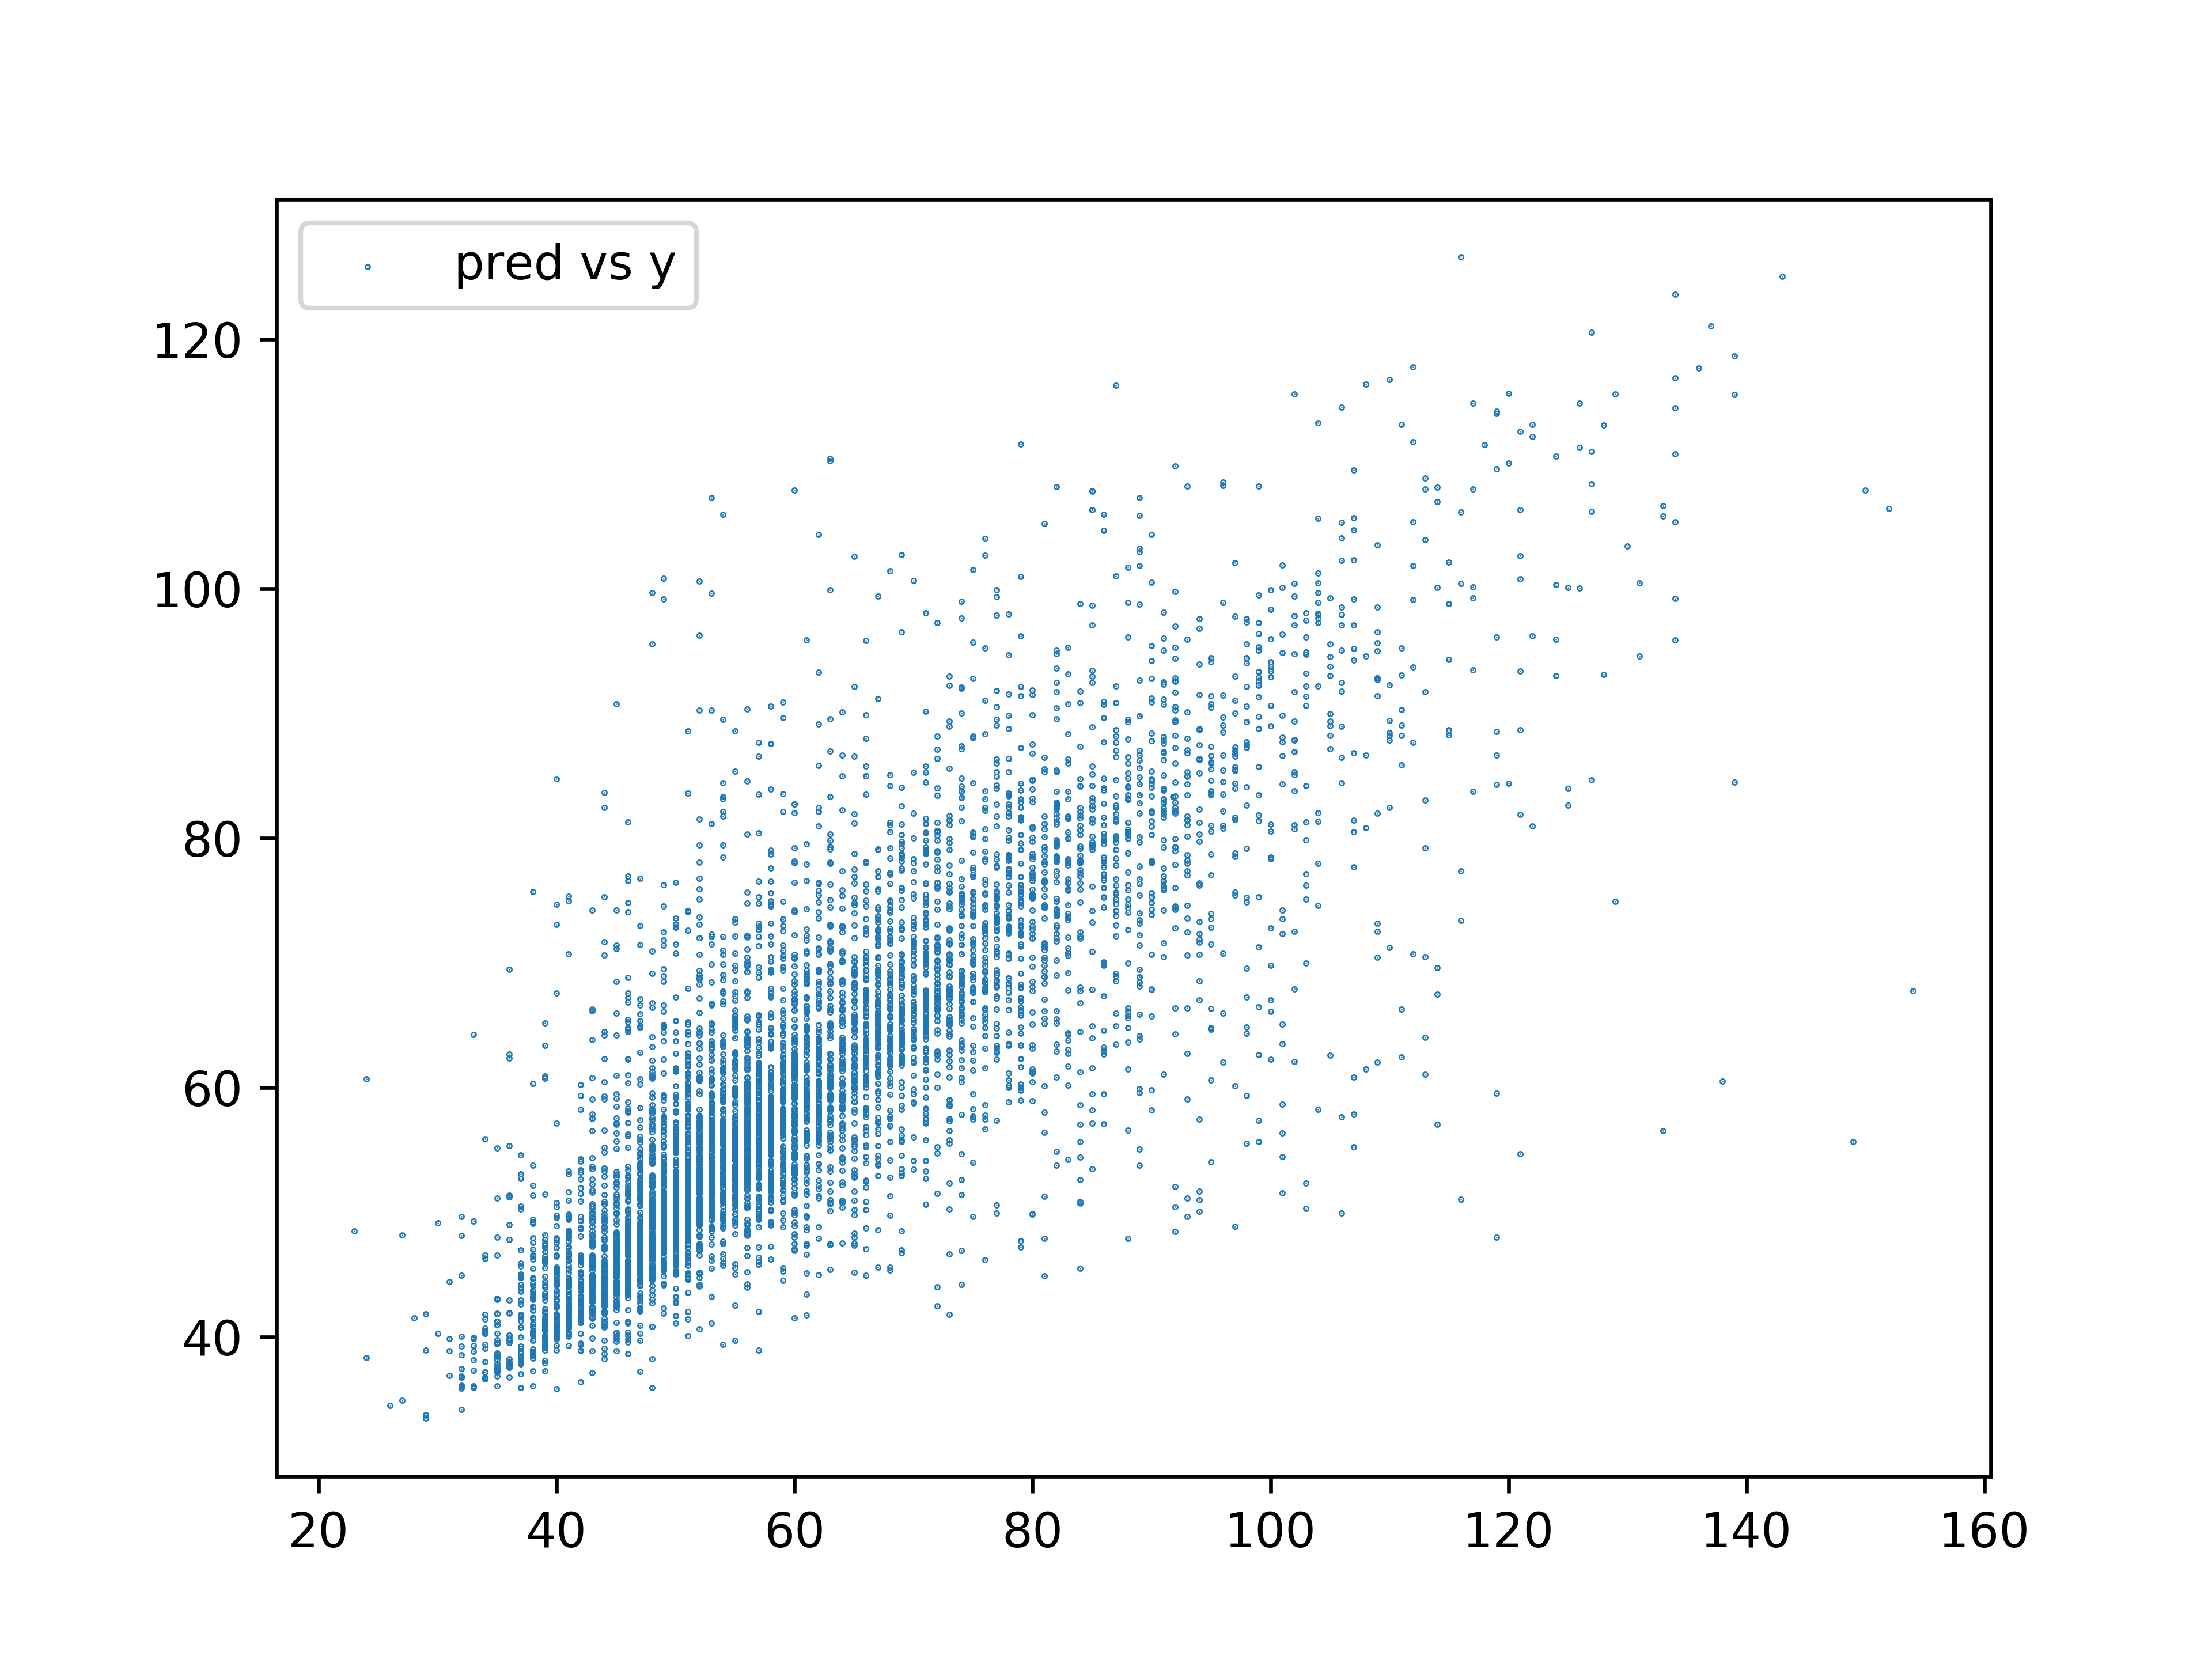
model as regressor – prediction of HbA1c at 12 months vs actual
r² 0.66
predicted HbA1c
observed HbA1c

Slide 27
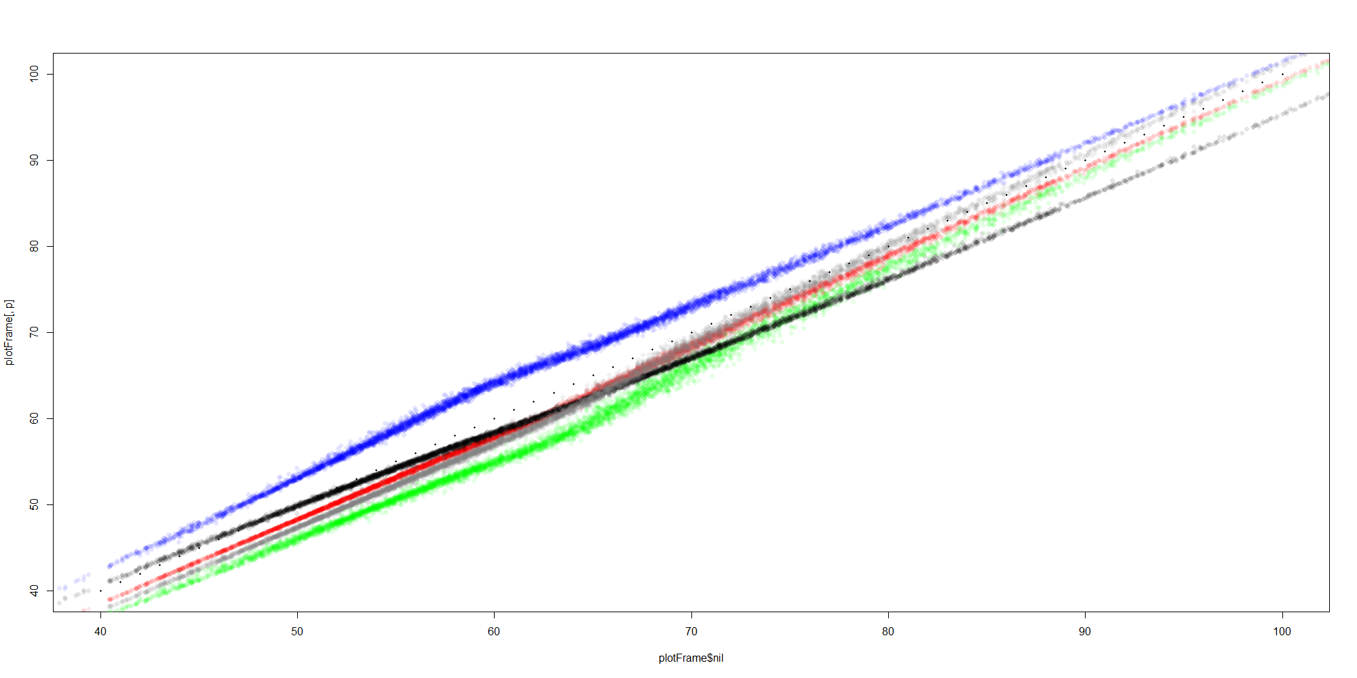
representation of predicted drug effects
predicted hba1c multiple possible drugs
comparator (baseline) drug combination

Slide 28
current performance
classifier – AUC (modelling actual drug therapy) 0.75 – 0.85
regressor – r² ~0.65
ongoing work
optimise neural network / layers used (LSTM vs convolutional etc)
explore alternative techniques (Gokhale/Tino baysian inference approach etc)
Notes:
Type 2 diabetes and the clinical problem. The management of type 2 diabetes is complex, and involves multiple domains of interest (average blood glucose, glucose variability over multiple timescales, blood pressure, cholesterol, urinary albumin, foot examination and risk etc (Orsi et al. 2018)), with clinical decisions made on the interaction of these (and multiple other) metrics over time. Clinical guidelines give a range of second and third etc line options, with a recommendation that precise choice should be made in response to the individual. Given that many individuals with diabetes are managed by non-specialist physicians and nurses, this has the potential to lead to suboptimal therapeutic strategies being adopted, and to therapeutic inertia (Khunti et al. 2018).
Machine learning approaches to time series analysis. Analysis of time-series data arising from multiple domains of interest noted above, in addition to time-invariant information (age, sex, ethnicity etc) can be used to understand the relationships between trends in these domains (dimensions) over time, and clinical outcomes of interest (eg reduction in HbA1c, blood pressure or mortality risk). Recurrent neural networks are an example of a machine learning approach that allows this insight to be achieved.
Aim of project. To generate a prediction of an individual’s response to any given clinically appropriate drug / combination of drugs (selection of test drugs driven by clinical guidelines) drawing on insight gained from the population over time.

Slide 29
some current issues
imbalanced classes
stochastic variation
hyperparameter tuning
diabetes classification issues
data sharing
downsampling / upsampling approaches
k-fold validation / averaging multiple runs
increase computational power / use small samples
unsupervised reclassification
synthetic data generation
Notes:
Type 2 diabetes and the clinical problem. The management of type 2 diabetes is complex, and involves multiple domains of interest (average blood glucose, glucose variability over multiple timescales, blood pressure, cholesterol, urinary albumin, foot examination and risk etc (Orsi et al. 2018)), with clinical decisions made on the interaction of these (and multiple other) metrics over time. Clinical guidelines give a range of second and third etc line options, with a recommendation that precise choice should be made in response to the individual. Given that many individuals with diabetes are managed by non-specialist physicians and nurses, this has the potential to lead to suboptimal therapeutic strategies being adopted, and to therapeutic inertia (Khunti et al. 2018).
Machine learning approaches to time series analysis. Analysis of time-series data arising from multiple domains of interest noted above, in addition to time-invariant information (age, sex, ethnicity etc) can be used to understand the relationships between trends in these domains (dimensions) over time, and clinical outcomes of interest (eg reduction in HbA1c, blood pressure or mortality risk). Recurrent neural networks are an example of a machine learning approach that allows this insight to be achieved.
Aim of project. To generate a prediction of an individual’s response to any given clinically appropriate drug / combination of drugs (selection of test drugs driven by clinical guidelines) drawing on insight gained from the population over time.

Slide 30
diabetes classification issues

Slide 31
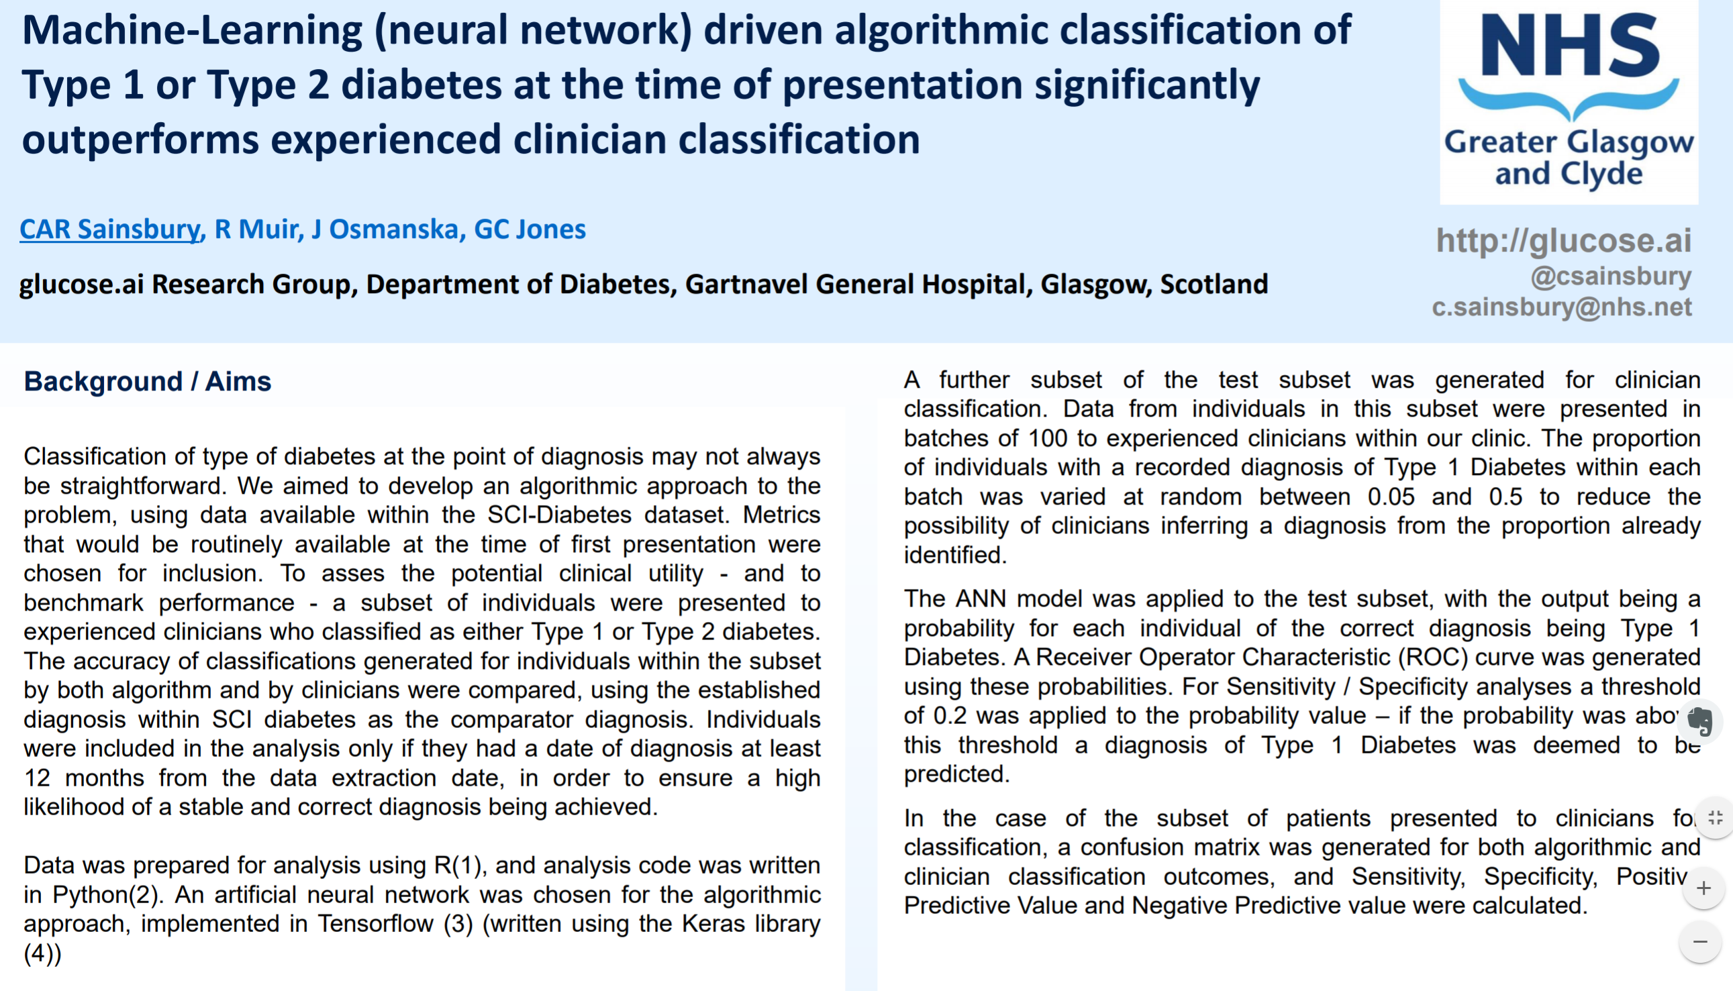
MSc (Stratified Medicine) project 2017

Slide 32
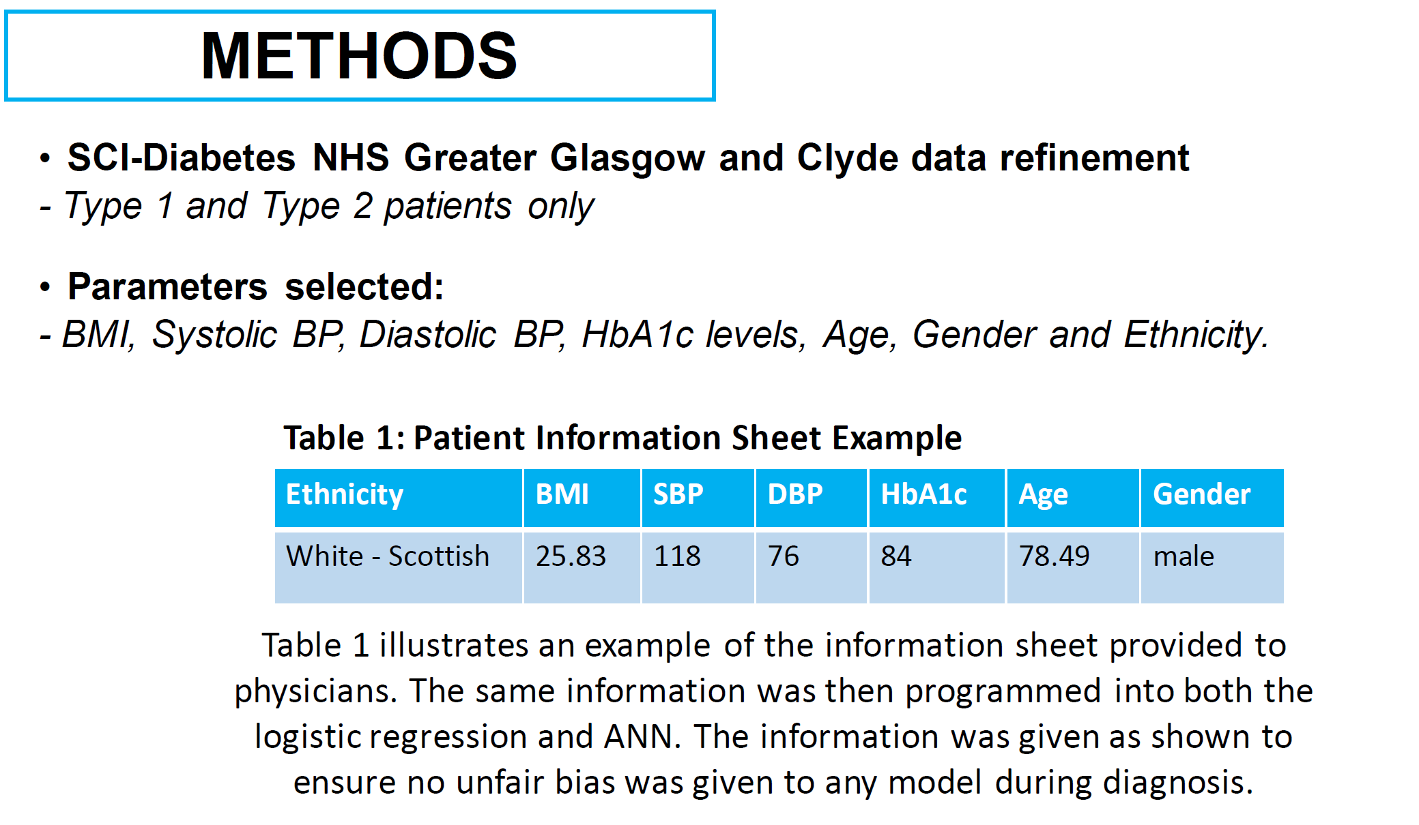
MSc (Stratified Medicine) project 2017

Slide 33
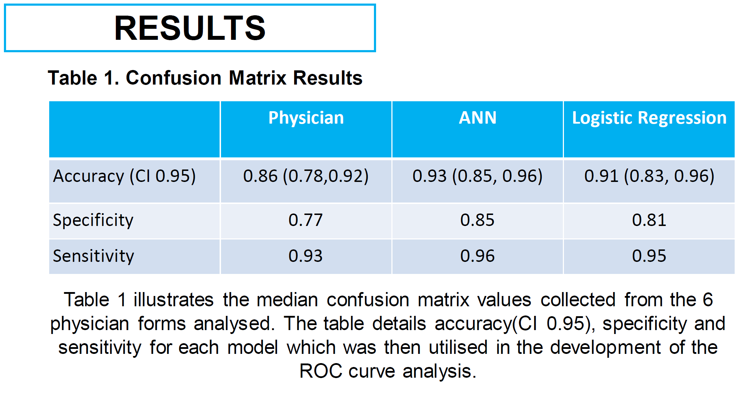
MSc (Stratified Medicine) project 2017

Slide 34
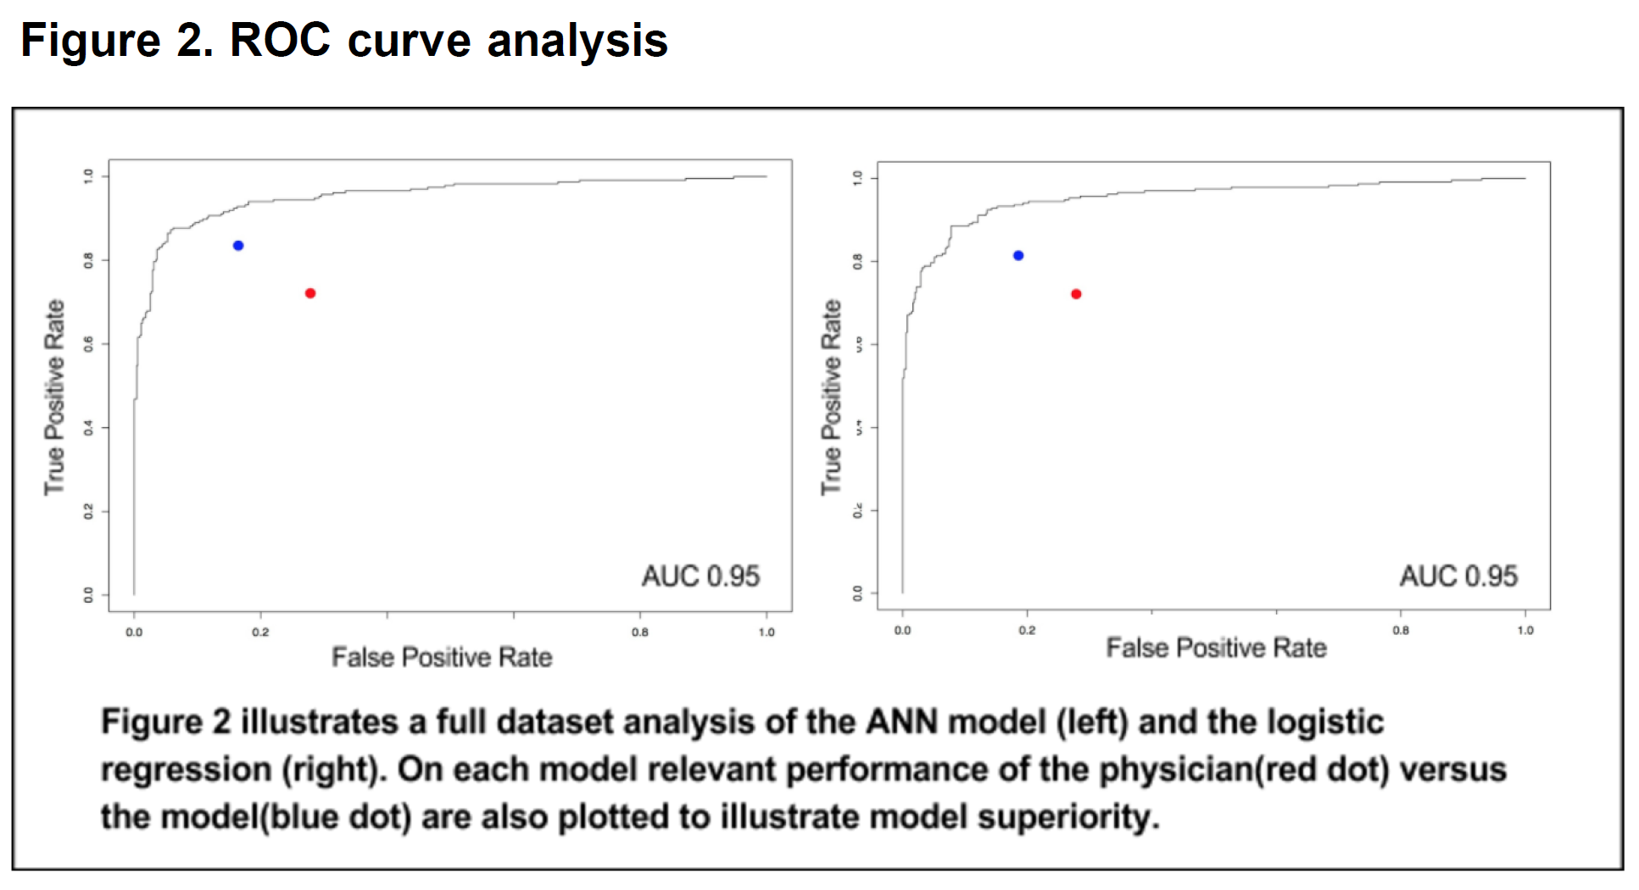

Slide 35
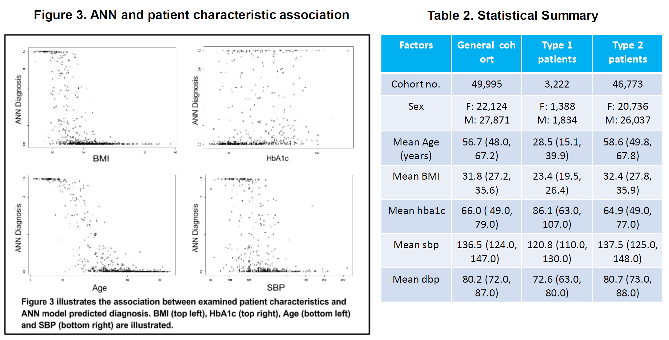

Slide 36
problem
are labels accurate?

Slide 37
problem / opportunities
1
to clean existing data
2
to investigate a data-driven, time series based classification
3
to find ‘missing’ diagnoses (MODY etc)

Slide 38
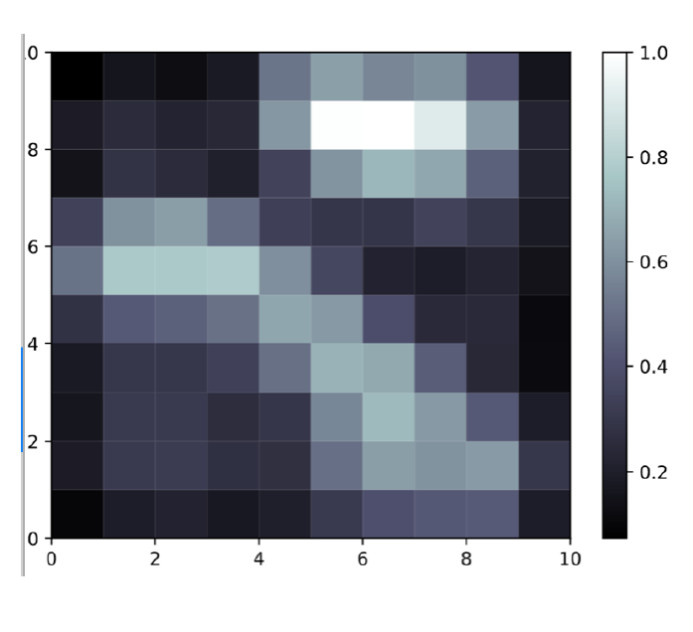
unsupervised approach
self organising map
ANN that allows dimensionality reduction
eg
2 dimensional representation of multidimensional input
in this context – can make assessment of probability of the correct label being applied
clean existing data

Slide 39
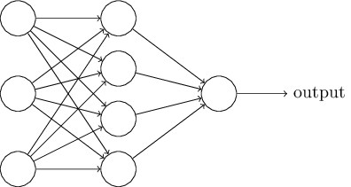
combined supervised / unsupervised approaches
+add human into the loop
clean existing data

Slide 40
input dataset
unsupervised analysis
algorithm 2
above threshold
output
classification
supervised analysis
algorithm 1
assess likely accuracy of prediction 1
prediction 1
below threshold
feedback & relabel for re-training
‘clinical’ prediction 2
send to reviewer
clean existing data

Slide 41
data-driven, time series based classification

Slide 42
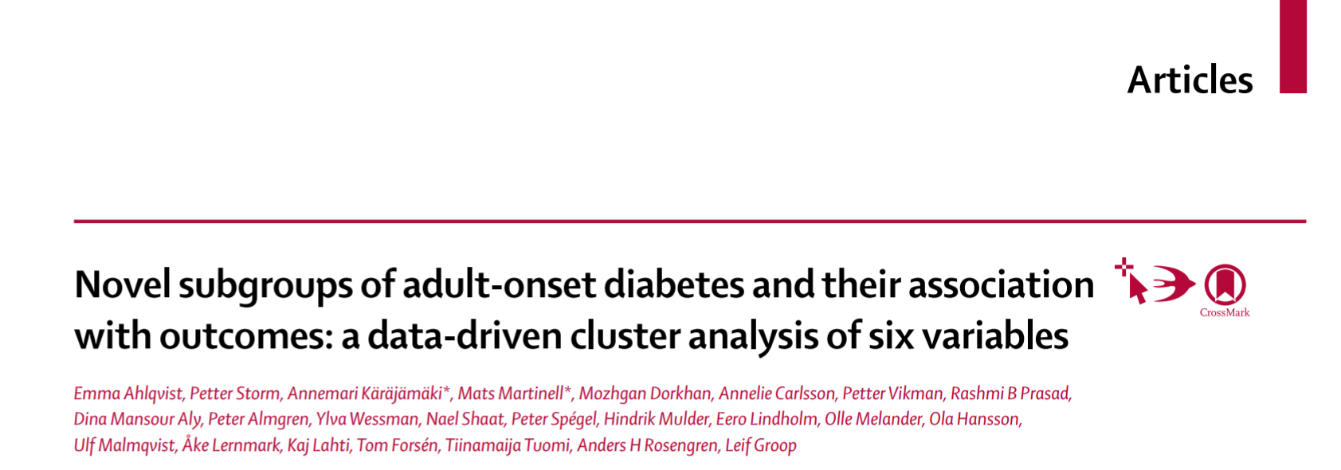
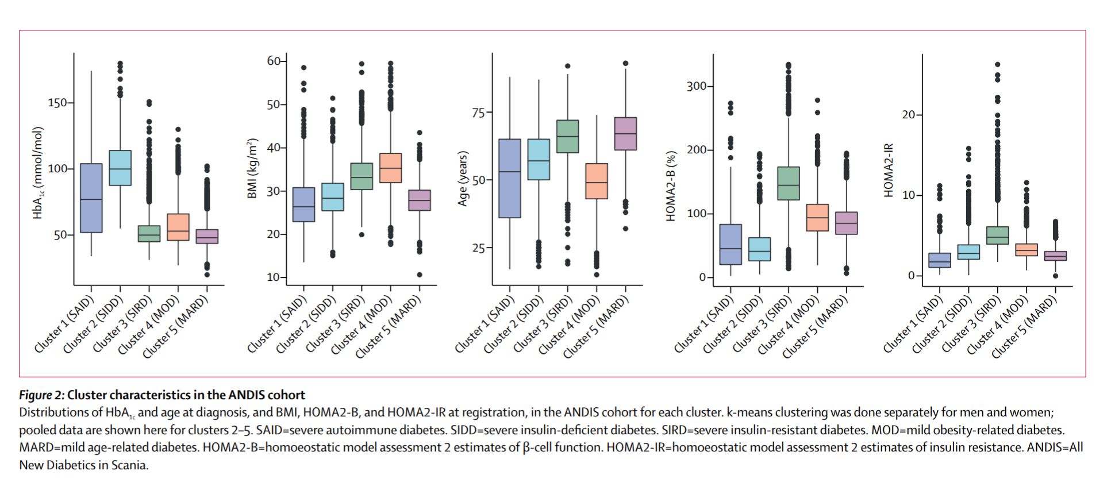
Notes:
Type 2 diabetes and the clinical problem. The management of type 2 diabetes is complex, and involves multiple domains of interest (average blood glucose, glucose variability over multiple timescales, blood pressure, cholesterol, urinary albumin, foot examination and risk etc (Orsi et al. 2018)), with clinical decisions made on the interaction of these (and multiple other) metrics over time. Clinical guidelines give a range of second and third etc line options, with a recommendation that precise choice should be made in response to the individual. Given that many individuals with diabetes are managed by non-specialist physicians and nurses, this has the potential to lead to suboptimal therapeutic strategies being adopted, and to therapeutic inertia (Khunti et al. 2018).
Machine learning approaches to time series analysis. Analysis of time-series data arising from multiple domains of interest noted above, in addition to time-invariant information (age, sex, ethnicity etc) can be used to understand the relationships between trends in these domains (dimensions) over time, and clinical outcomes of interest (eg reduction in HbA1c, blood pressure or mortality risk). Recurrent neural networks are an example of a machine learning approach that allows this insight to be achieved.
Aim of project. To generate a prediction of an individual’s response to any given clinically appropriate drug / combination of drugs (selection of test drugs driven by clinical guidelines) drawing on insight gained from the population over time.

Slide 43
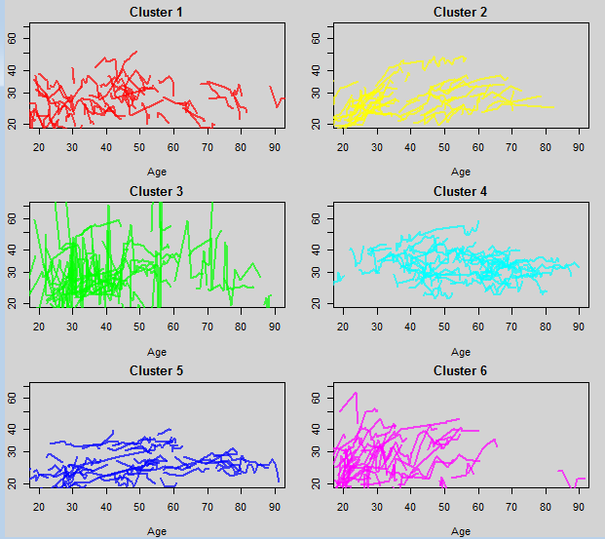
2. clustering approach using TS data
HbA1c
BP
BMI
biochem
drugs / drug response
Example: pattern mining for BMI trajectory analysis
(THIN data)

Slide 44
3. identify missing diagnoses
difficult as small sample size to work from (but may be confident in label accuracy)
upsampling ideal to maximise value from data
synthetic data
potential to help with another problem – data sharing

Slide 45
requirements for synthetic data generator
generate multi-dimensional time series data
reflect distributions of individual parameters
include interactions/associations between parameters over time
allow training models on synthetic data that will perform well on real data

Slide 46
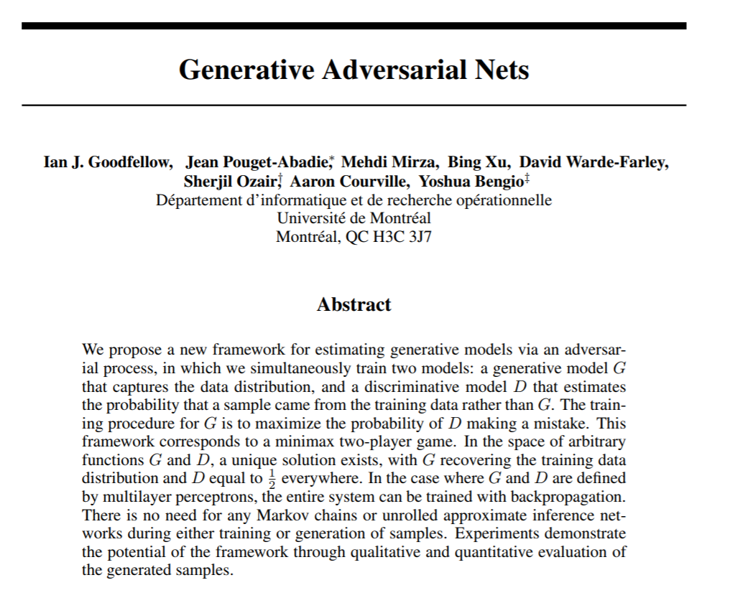
GANs
arXiv:1406.2661

Slide 47
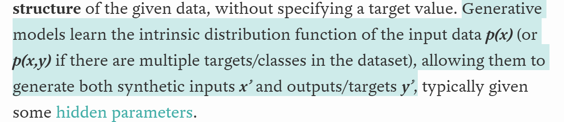

Slide 48
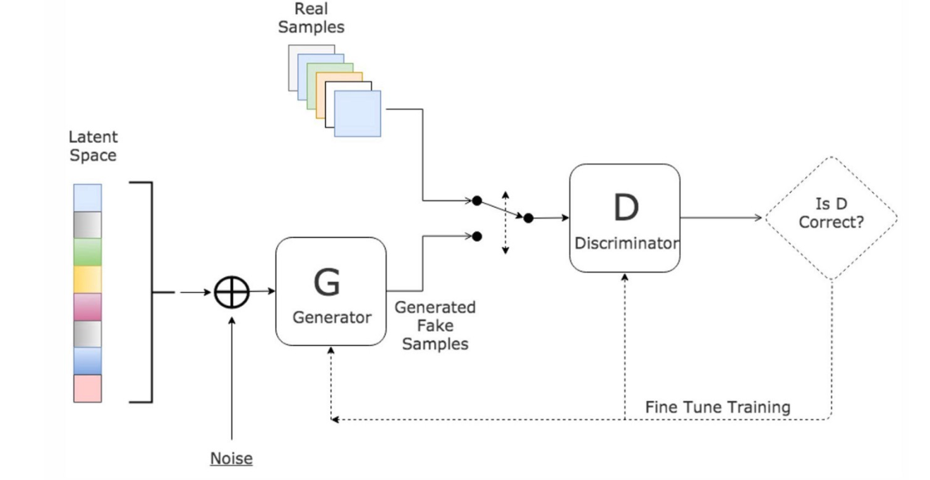

Slide 49
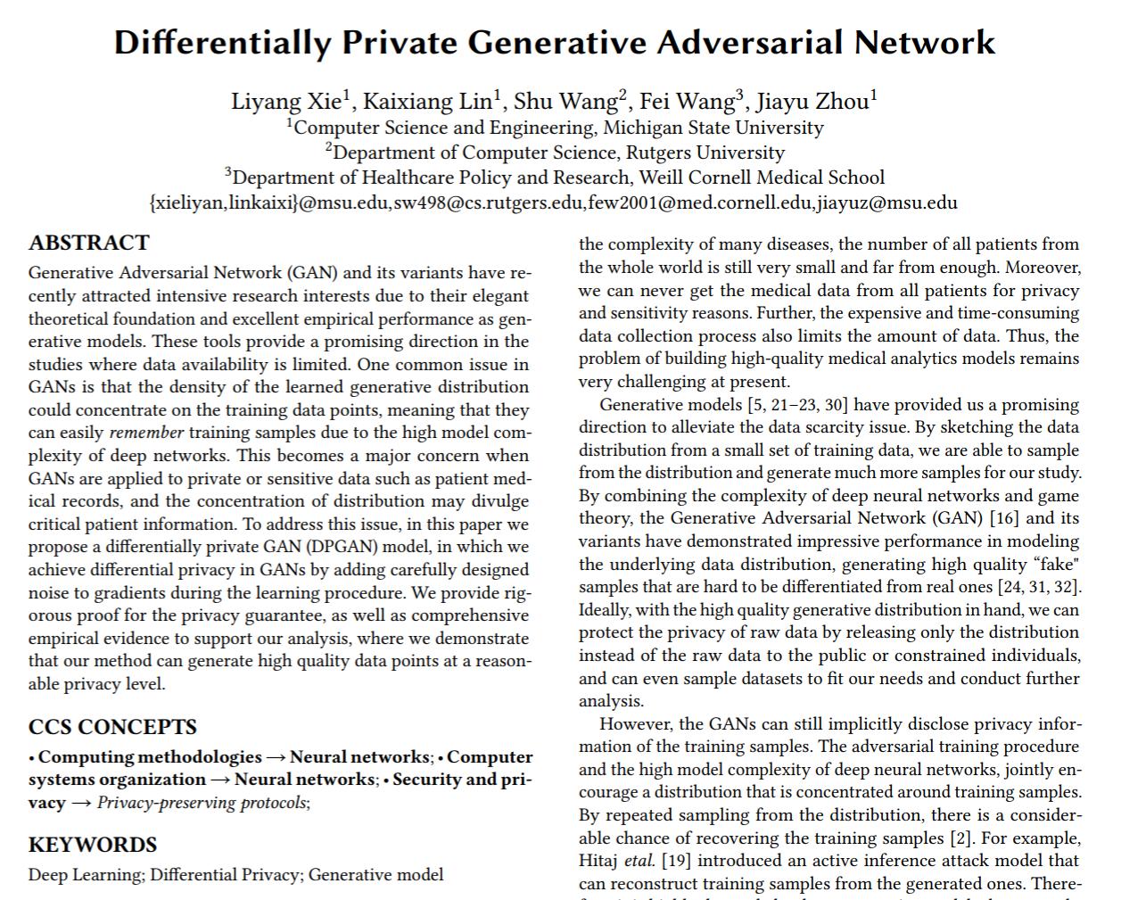
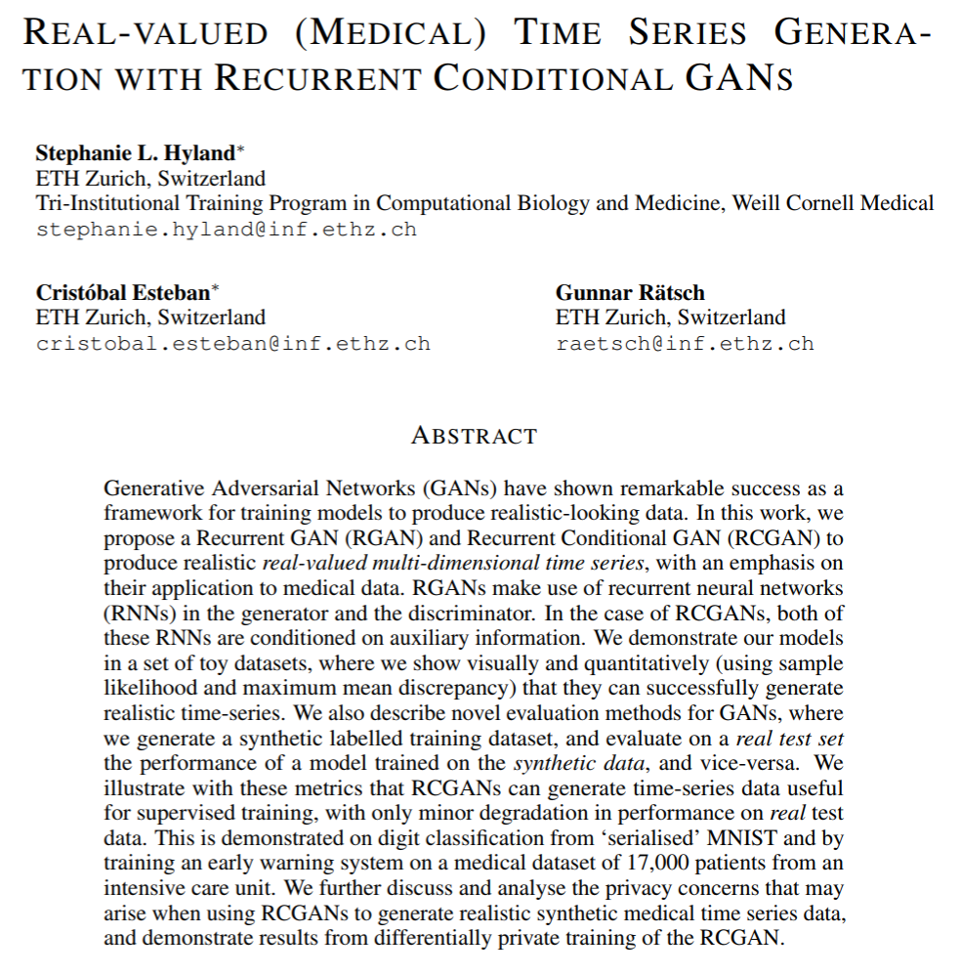
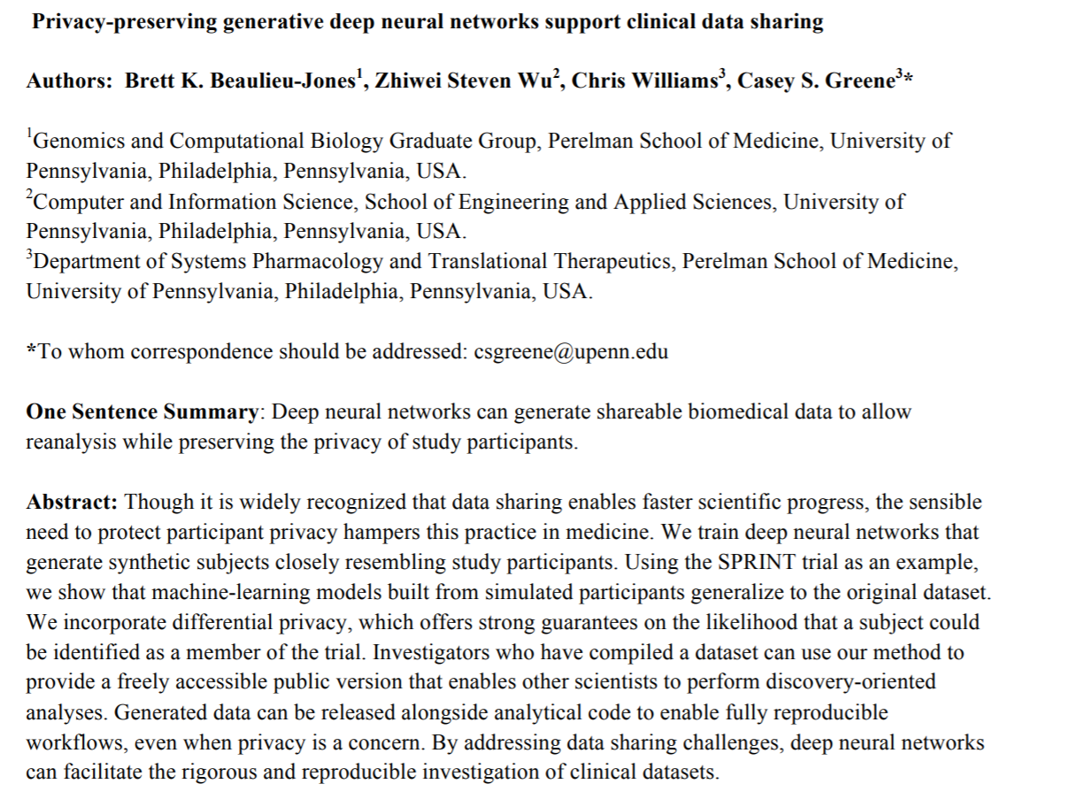
arXiv:1802.06739
arXiv:1706.02633
https://doi.org/10.1101/159756

Slide 50
real time-series data
synthetic time-series data
differential privacy inhibits data leakage
quality vs security tradeoff
privacy budgets
computational limits

Slide 51
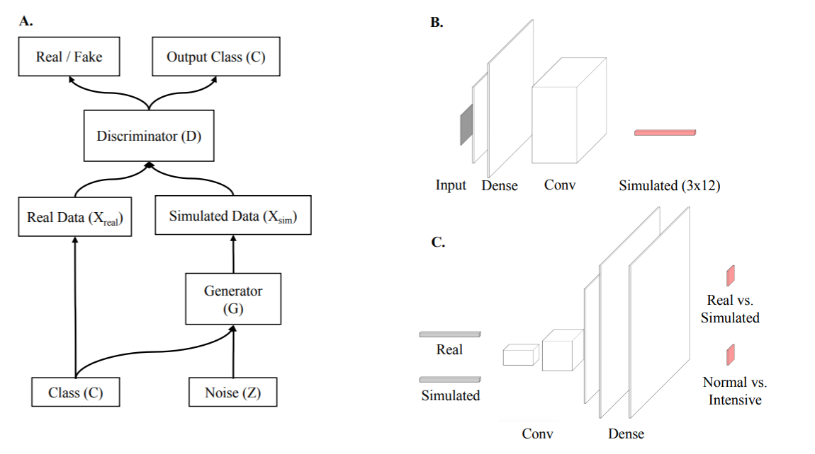
beaulieu-jones et al 2017. doi: https://doi.org/10.1101/159756

Slide 52
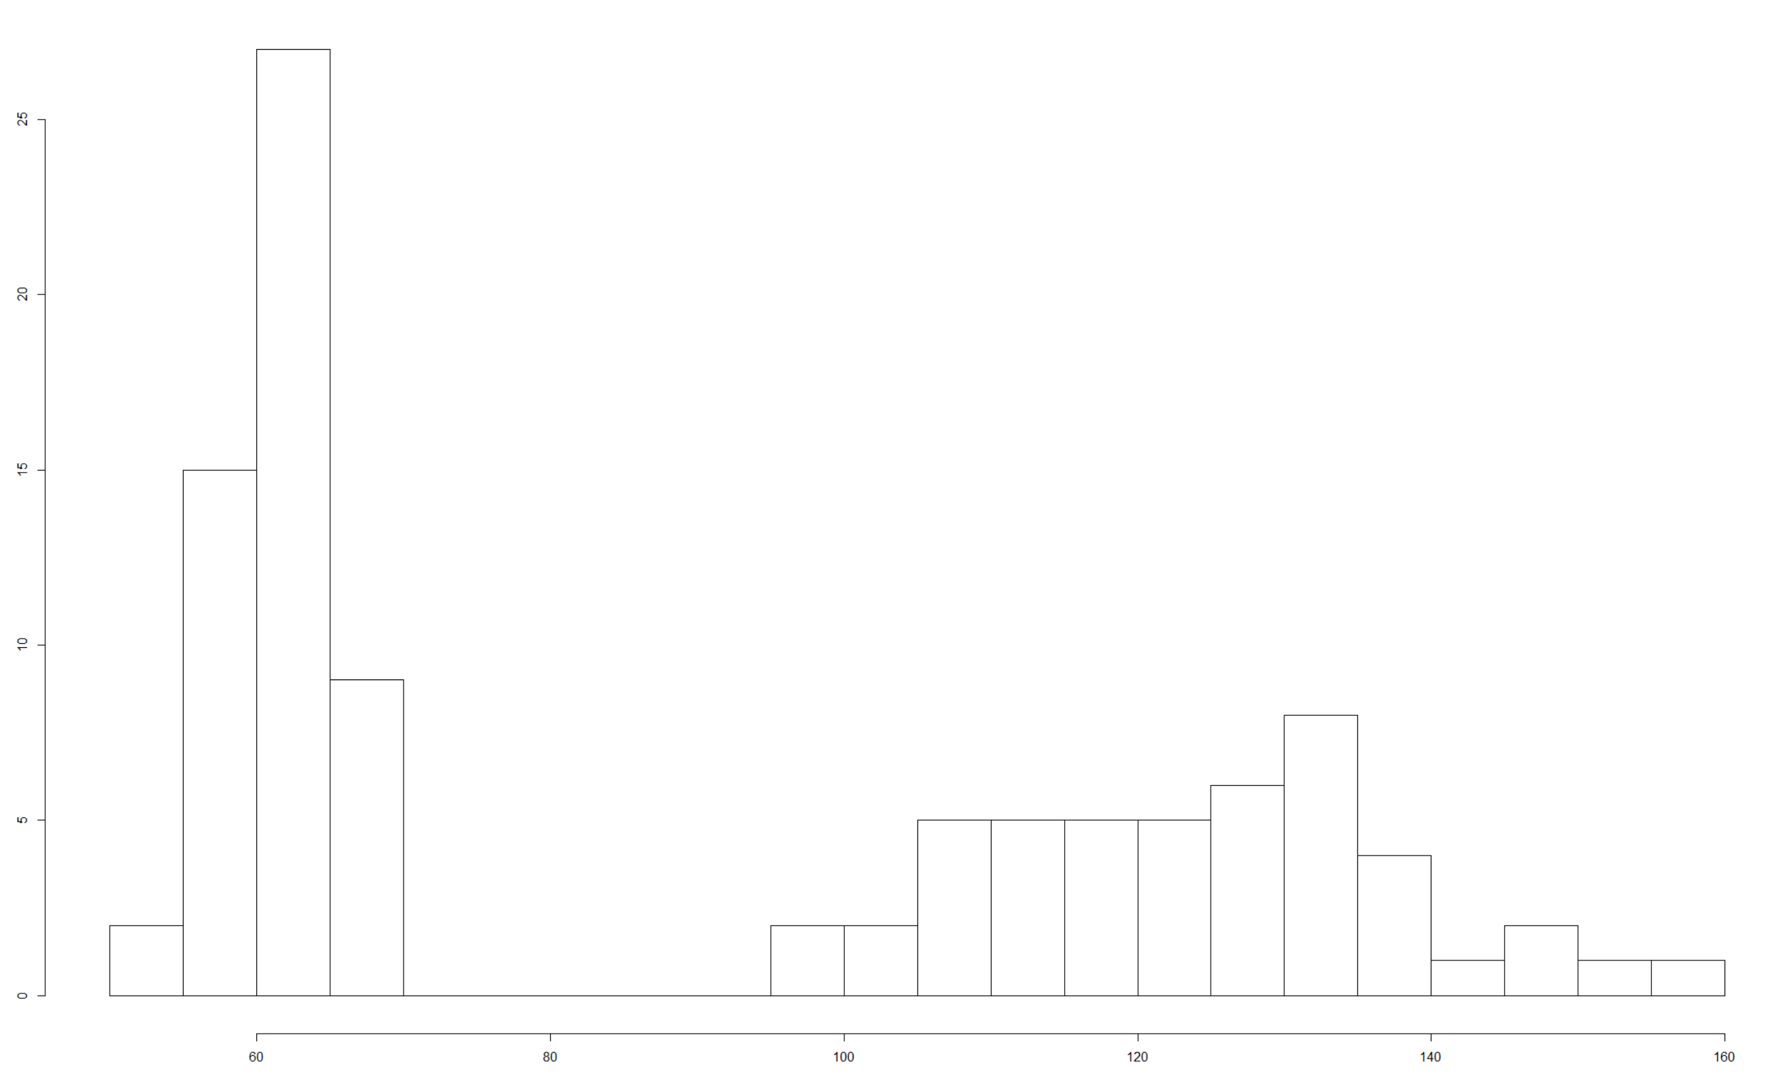
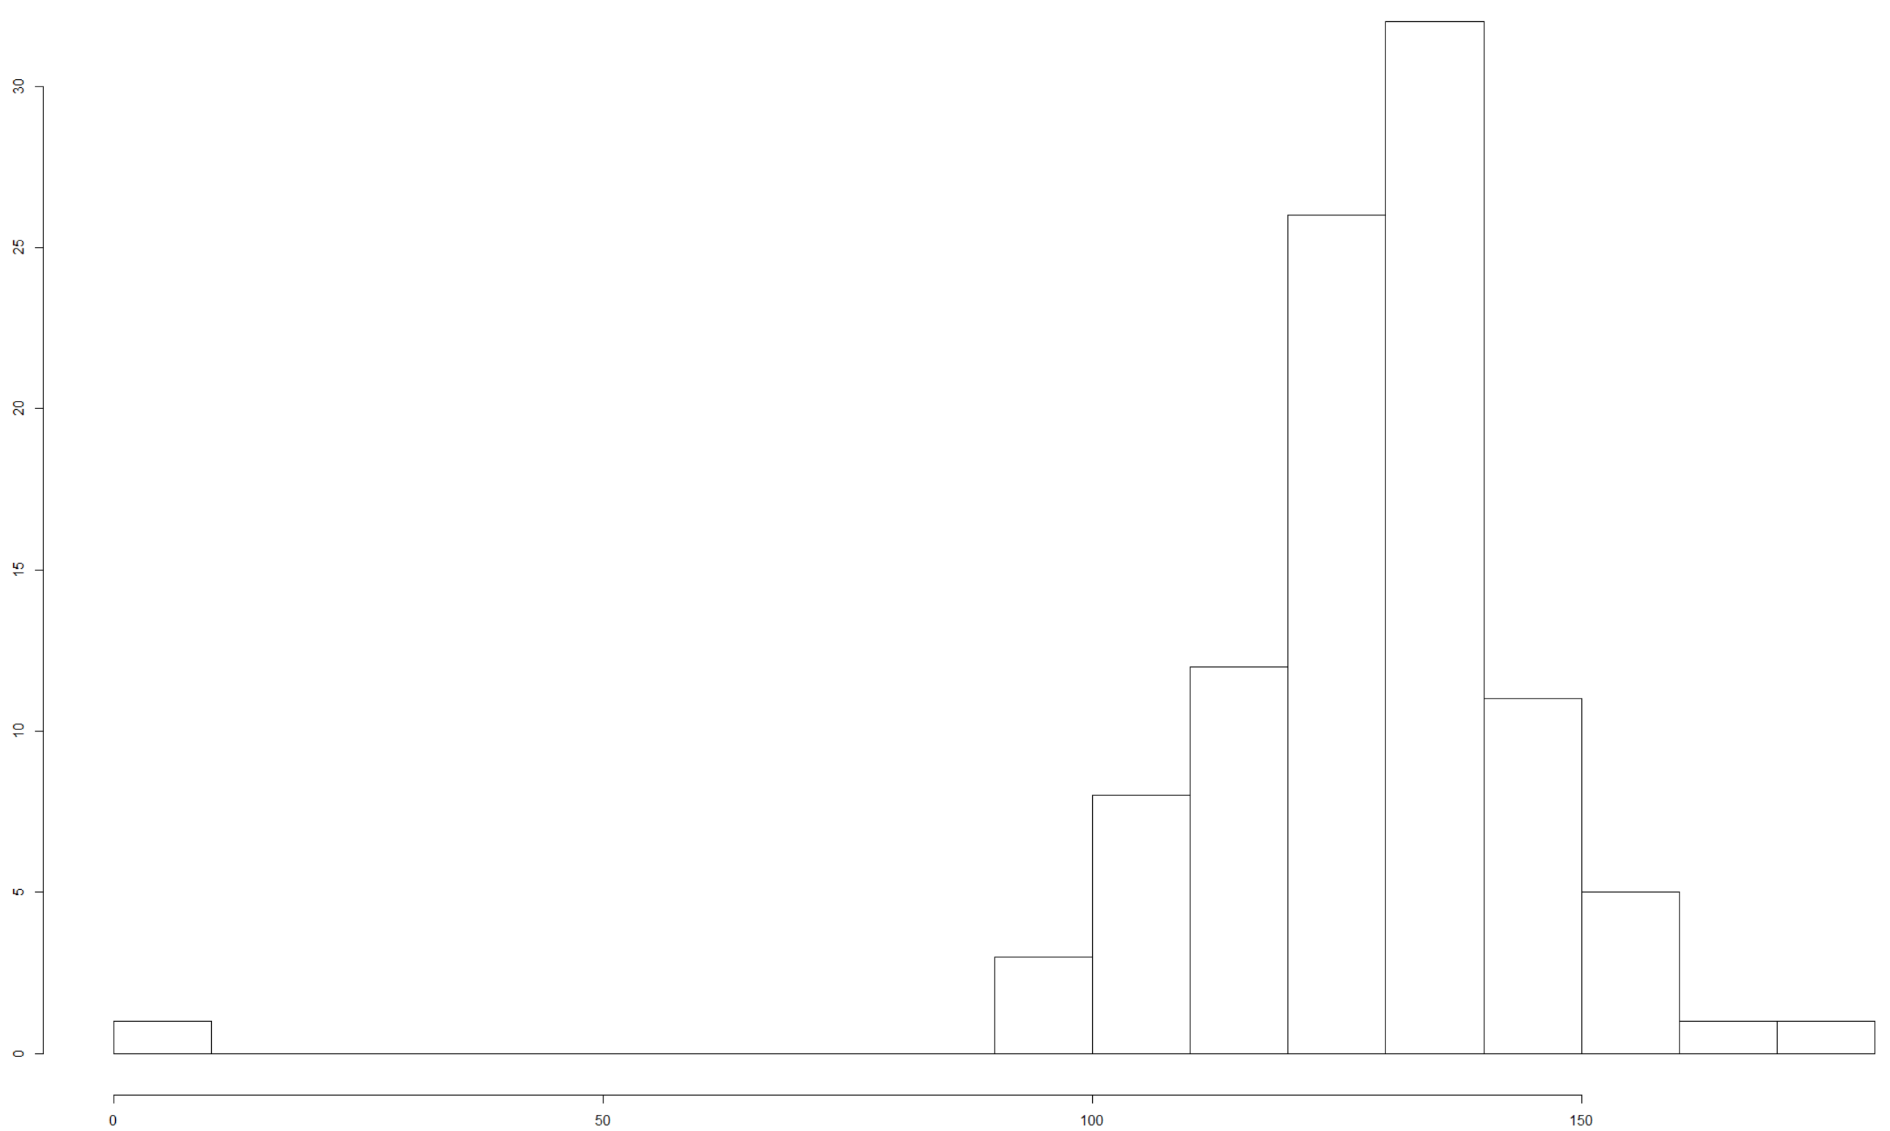
synthetic
‘true’
GAN vs true generated systolic BP distributions – 100 epochs with differential privacy
single time point, 100 ‘IDs’

Slide 53
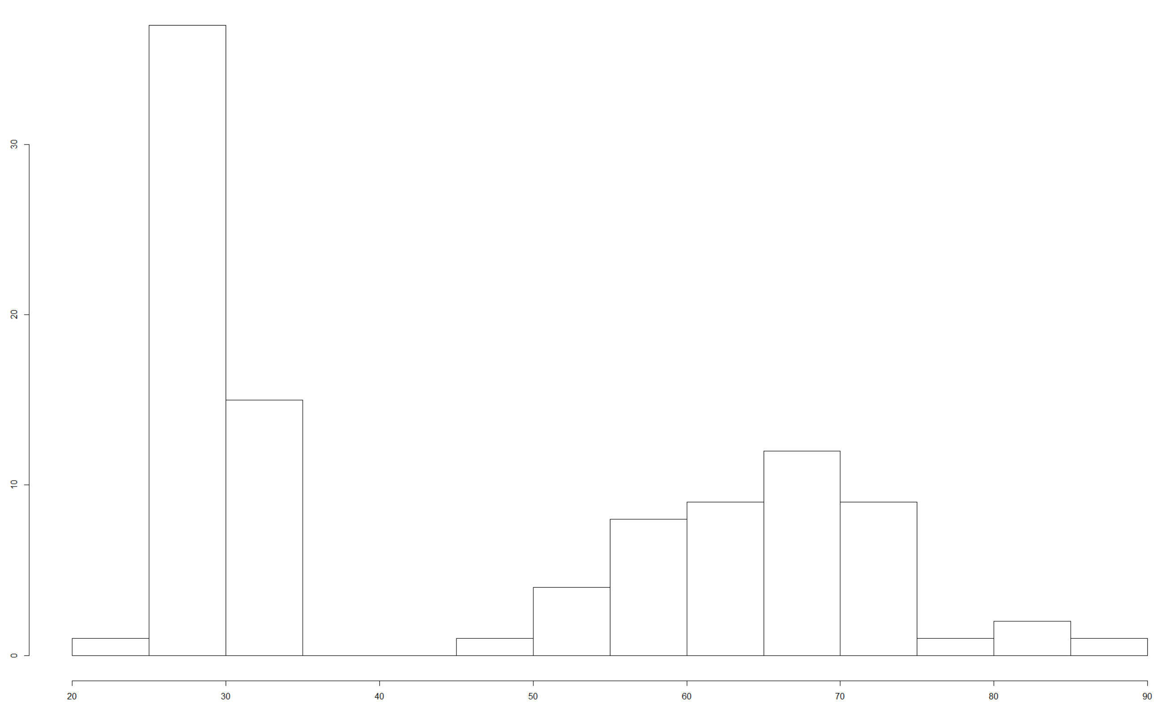
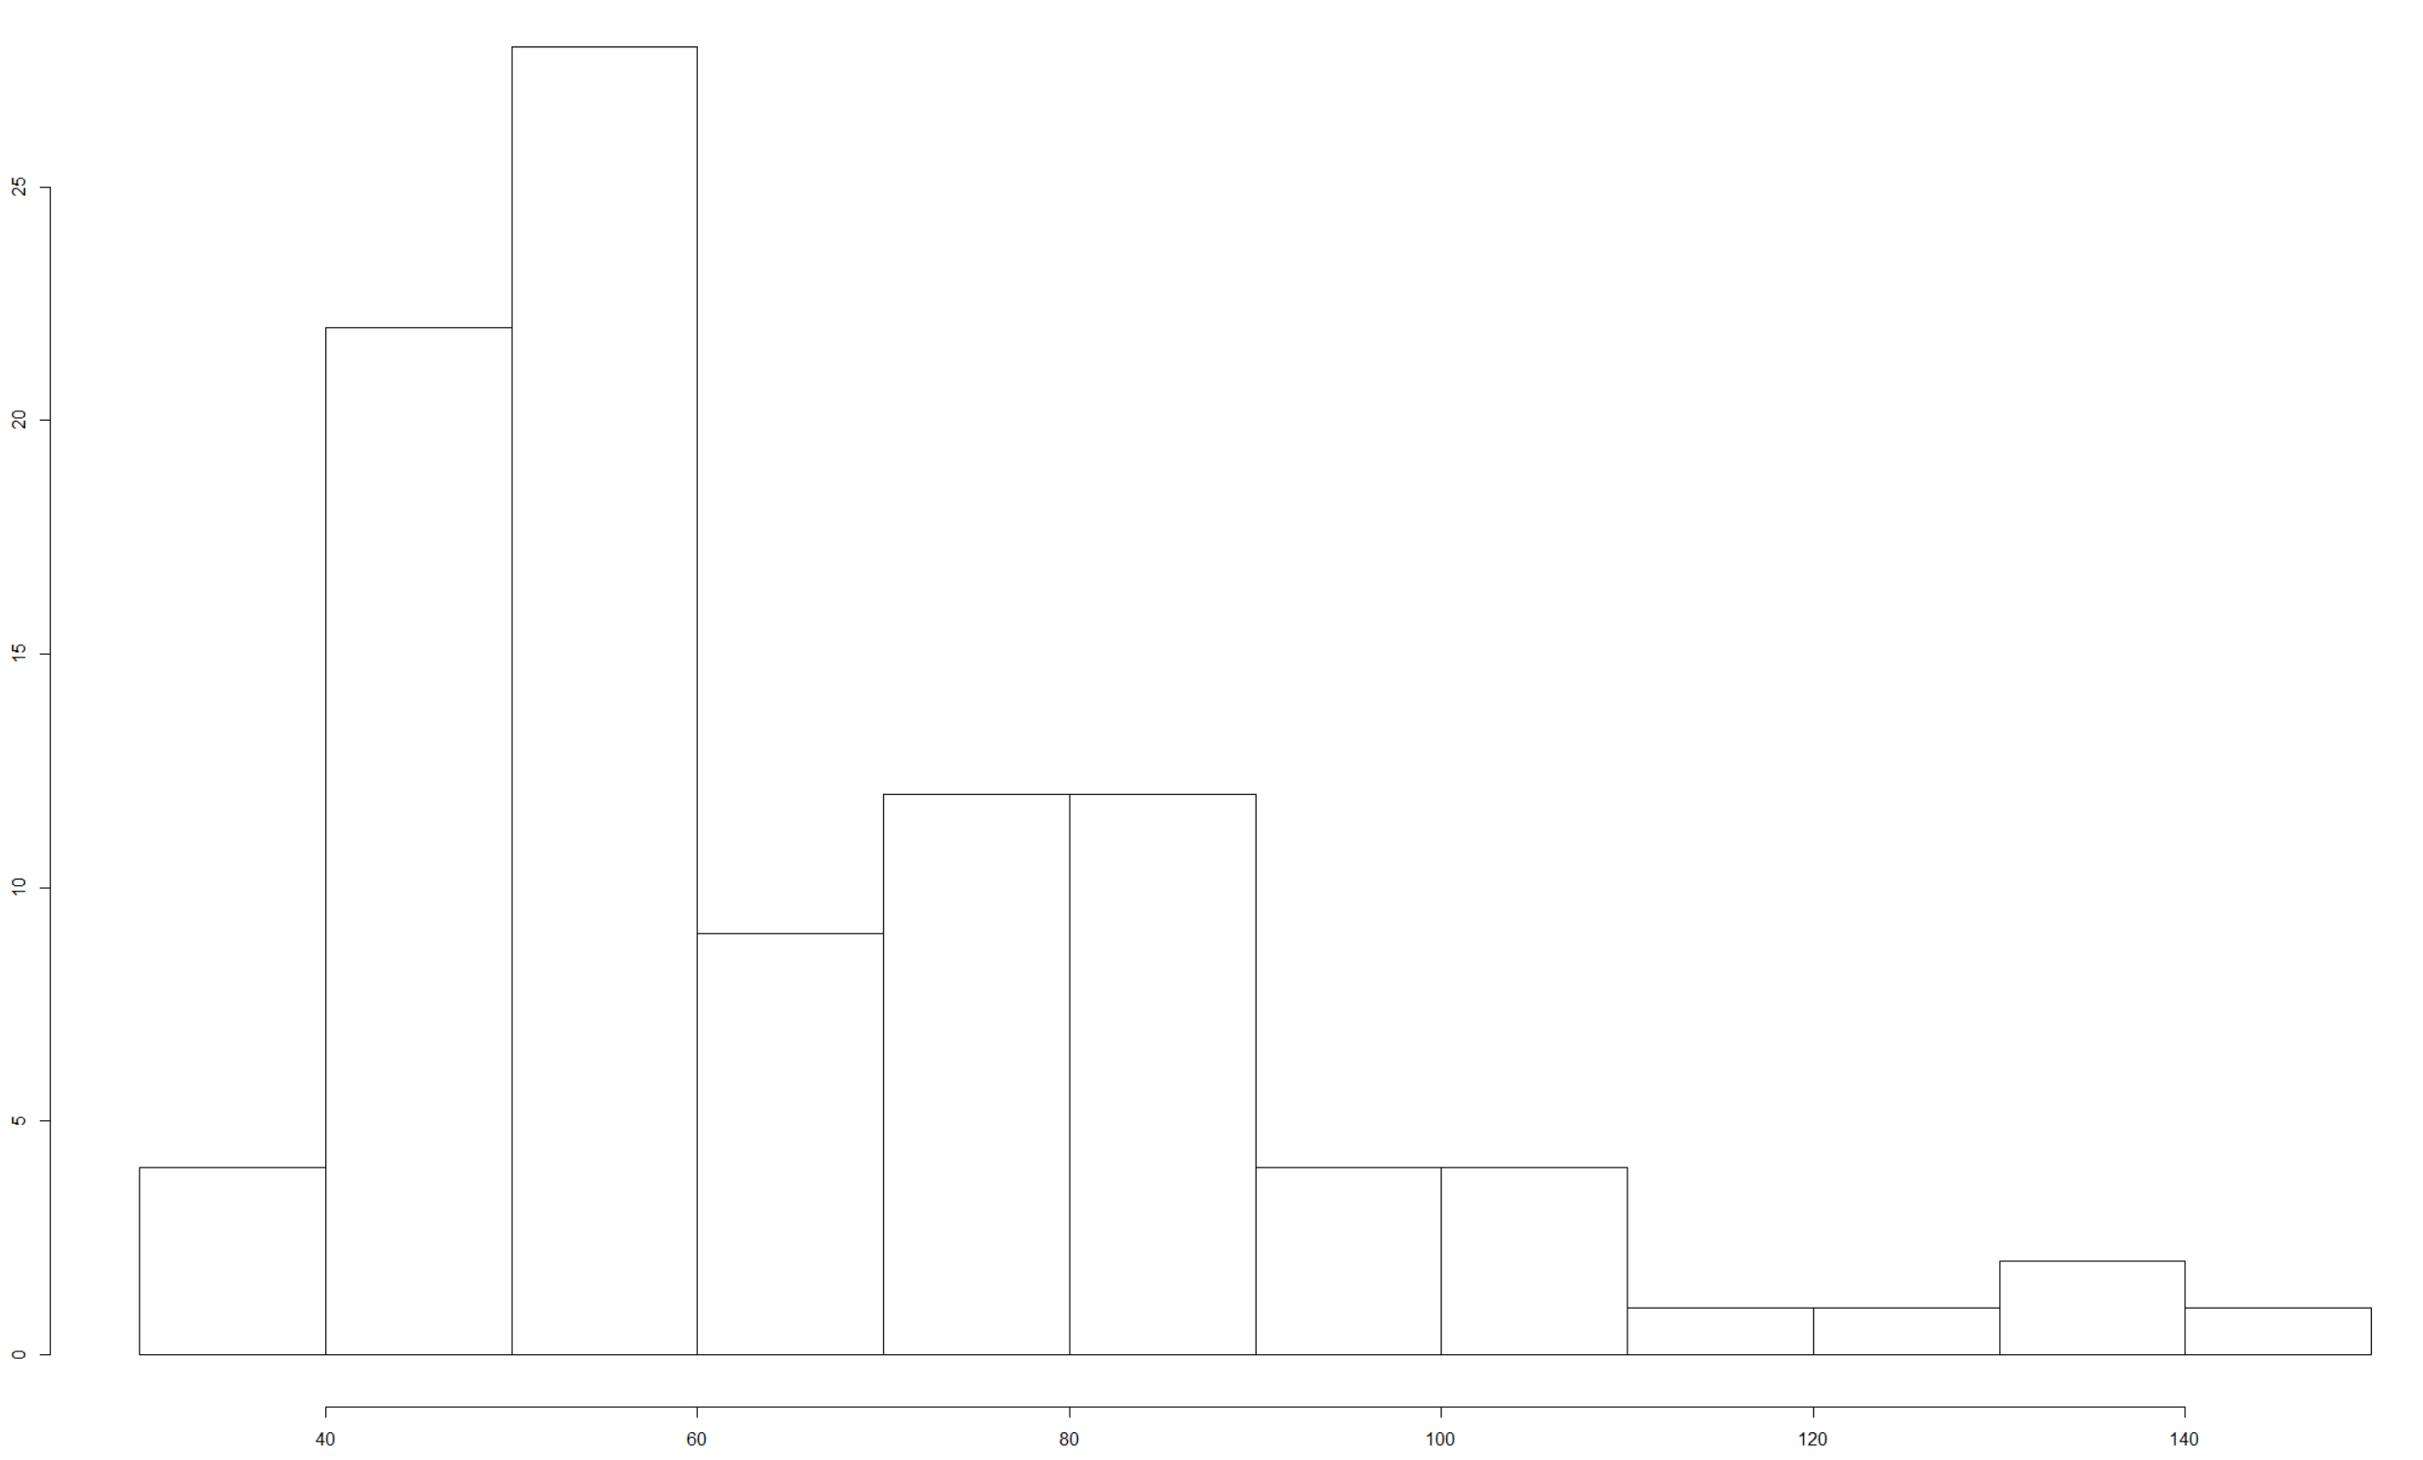
synthetic
‘true’
GAN vs true generated HbA1c distributions – 100 epochs with differential privacy
single time point, 100 ‘IDs’

Slide 54
potential uses of GANs generated synthetic data
balance classes (upsampling)
with dp implemented – allow data sharing
with further development can be used as classifier/regressors – may provide a general solution to all problems discussed

Slide 55
glucose.ai group, NHS GGC
Greg Jones
Debbie Morrison
Sean Harbison
Stratified Medicine MSc students
Ruth Muir
Alastair Irvine
Halah al Saadi
myDiabetesIQ
Debbie Wake
Scott Cunningham
Nicky Conway
Sam Philip
Felix Agakov
thinkingAI group, University of Birmingham
Krish Nirantharakumar
Krishna Gokhale
Tom Taverner
Peter Tino
Notes:
Type 2 diabetes and the clinical problem. The management of type 2 diabetes is complex, and involves multiple domains of interest (average blood glucose, glucose variability over multiple timescales, blood pressure, cholesterol, urinary albumin, foot examination and risk etc (Orsi et al. 2018)), with clinical decisions made on the interaction of these (and multiple other) metrics over time. Clinical guidelines give a range of second and third etc line options, with a recommendation that precise choice should be made in response to the individual. Given that many individuals with diabetes are managed by non-specialist physicians and nurses, this has the potential to lead to suboptimal therapeutic strategies being adopted, and to therapeutic inertia (Khunti et al. 2018).
Machine learning approaches to time series analysis. Analysis of time-series data arising from multiple domains of interest noted above, in addition to time-invariant information (age, sex, ethnicity etc) can be used to understand the relationships between trends in these domains (dimensions) over time, and clinical outcomes of interest (eg reduction in HbA1c, blood pressure or mortality risk). Recurrent neural networks are an example of a machine learning approach that allows this insight to be achieved.
Aim of project. To generate a prediction of an individual’s response to any given clinically appropriate drug / combination of drugs (selection of test drugs driven by clinical guidelines) drawing on insight gained from the population over time.

